Slide 1
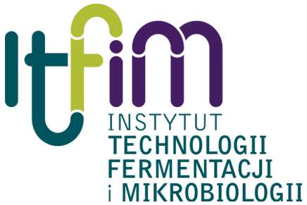
Probiotics in human nutrition
Agnieszka Chlebicz
Katarzyna Śliżewska

Slide 2
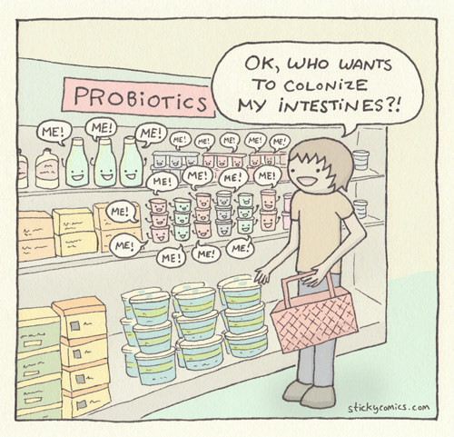
What are probiotics?
”Live microorganisms which when administered in adequate amount confer a health benefits on the host”
Źródła: [2, 11]

Slide 3
What they should be like?
Generally Recognized As Safe (GRAS)/ Qualified Presumption of Safety (QPS)
Isolated from safe environment
Genetically stable
Nonpathogenic
Resistant o bile acids and low pH
Adhesive to epithelial cells
Pathogens antagonists
Źródła: [1, 7]

Slide 4
What probiotics can do?
Antimicrobial effect
Synthesizing antmicrobial products
Mucin production regulation
Immune modulation
Activation of lymphocytes
Enhacement of mucosla barrier integrity
Competitive exclusion
Production of antibodies
Stimulation of cells involved in innate and adaptive immunity
Proper tight junction proteins expresion
Detoxification properties
Absorption
Metabolism
Źródła: [3, 4, 6]

Slide 5
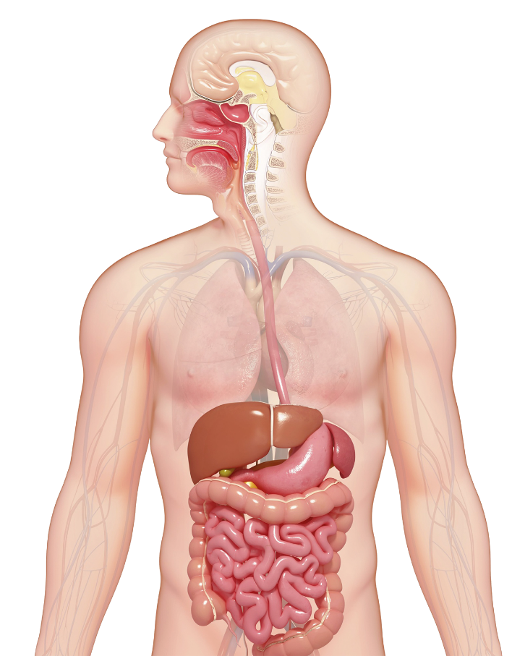
Impact of probiotics on human health
Altered GI tract microecology
Inhibit pathogen growth and translocation. Reduce risk of infection from common pathogens (Salmonella, Shigella)
Improve digestion of lactose and reduce intestinal bloating, flatulence and discomfort
Detoxify carcinogens Suppress tumours
Reduce risk of obesity
Probiotics
Lower serum cholesterol concentrations
Decrease faecal mutagenicity
Decrease faecal bacterial enzyme activity
Enhance specific and non-specific immune response
Relieve constipation
Increase nutrient bioavailability, increase mineral absorption
Shortage the duration of rotavirus diarrhoea
Źródła: [4]

Slide 6
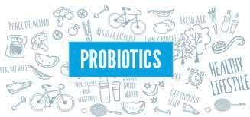
Route to become a probiotic microorganism
Isolation from selected environment
Bile and acids tolerance
Adherence to epithelial cells
In vitro testing
Antagonistic activity
In vivo testing
Genome description
Toxicology
Designation of target population
Źródła: [5, 8, 9]

Slide 7
Probiotics used in human nutrition
Lactobacillus species | Bifidobacterium species | Other Lactic Acid Bacteria | Other Microorganisms
L. acidophilus ^{(a),}* L. amylovorus ^{(b),}* L. casei ^{(a),(b),}* L. gasseri ^{(a),}* L. helveticus ^{(a),}* L. johnsonii ^{(b),}* L. pentosus ^{(b),}* L. plantarum ^{(b),}* L. reuteri ^{(a),}* L. rhamnosus ^{(a),(b),}* | B. adolescentis ^{(a)} B. animalis ^{(a),}* B. bifidum ^{(a)} B. breve ^{(b)} B. infantis ^{(a)} B. longum ^{(a),}* | Enterococcus faecium ^{(a)} Lactococcus lactis ^{(b),}* Streptococcus thermophilus ^{(a),}* | Bacillus clausii ^{(a),}* Escherichia coli Nissle 1917 ^{(a)} Saccharomyces cerevisiae (boulardi) ^{(a),}*
^{(a)} Mostly as pharmaceutical products; ^{(b)} mostly as food additives; * QPS (Qualified Presumption of Safety) microorganisms.
Źródła: [4]

Slide 8
Examples of commercial probiotic products
Strain | Commercial products | Sources
Saccharomyces cerevisiae boulardii | Florastor | Biocodex (Creswell, OR)
Bifidobacterium infantis 35,264 | Align | Procter and Gamble (Mason, OH)
Lactobacillus casei strain Shirota Bifidobacterium breve strain Yakult | Yakult | Yakult (Tokyo, Japan)
Lactobacillus casei DN-114 001 Bifidobacterium animalis DN173 010 | DanActive Activia yogurt | Danone (Paris, France) Dannon (Tarrytown, NY)
Lactobacillus johnsonii Lj-1 (same as NCC533 and formerly Lactobacillus acidophilus La-1) | LC1 | Nestle (Lausanne, Switzerland)
Lactobacillus reuteri ATCC 55,730 (“L. reuteri Protectis”) | BioGaia Probiotic chewable tablets or drops | Biogaia (Stockholm, Sweden)
Lactobacillus rhamnosus GG (“LGG”) | Culturelle; Dannon | Danimals Valio Dairy (Helsinki, Finland) The Dannon Company (Tarrytown, NY)
The 2015 global probiotic market size by revenue exceeded 35 billion USD
Źródła: [10]

Slide 9
Probiotic food products
Dairy products such as yoghurt and kefir, cottage cheese or ripened cheese fermented with probiotic strains. About 2-5x10¹⁰ cells/100 gram portion.
Ice cream or frozen dessert. Probiotic bacteria concentration of about 10⁷ cells/g.
Chocolates or cakes with lyophilised probiotic bacteria at concentration of about 10⁷ cells/g.
Soft drinks with probiotic bacteria (CocoBiotic – fermented with Lactobacillus acidophilus; Lactobacillus delbreuckii; Saccharomyces cerevisiae boulardii): 4 billion cfu)

Slide 10
Probiotic products
In lyophilised form – usually 10¹⁰ cells/g. Shelf life about 1 year. Sold as drugs or dietary supplements. Sometimes encapsulated.
Infant formula (powdered milk) with lyophilised probiotic bacteria at concentration of about 10⁷ cells/g.
Probiotic BioGaia chewing gum with Lactobacillus reuteri Prodentis. Balancing the oral flora and reducing the level of harmful bacteria associated with oral problems.
A screw cap for use on PET bottles which releases probiotic bacteria into the beverage.
LifeTop Straw which releases probiotic bacteria into drink upon piercing with the straw.
Probiotic sticks contain a blend of Lactobacillus acidophilus Rossell-52 and Bifidobacterium longum Rossell-175 in a micro-encapsulated fruit flavoured powder form.

Slide 11
There are more beings in the world than just us, humans…

Slide 12
”Synbiotic preparation for monogastric animals health prophylaxis and prevention of bacterial diseases and mycotoxin-related intoxications, as well as to improve animal nourishment and animal breeding eficiency” (PBS3/A8/32/2015)
Research funded by The National Center for Research and Development
Colaboration:
Department of Swine Diseases of National Veterinary Research Institute placed in Pulawy
Department of Biotechnology and Food Microbiology, Poznan University of Life Sciences
Department of Pathology and Veterinary, Warsaw University of Life Science – SGGW
Department of Animal Nutrition and Feed Science, University of Warmia and Mazury in Olsztyn
JHJ Sp. z o. o. company

Slide 13
If we succeed…
Designed synbiotic for livestock
Less pathogenic bacteria in intestinal microflora
Less contaminated food products
Less zoonotic diseases in humans
Better breeding efficiency
Higher detoxification of mycotoxin administrated with feed
Less intoxications in humans

Slide 14
References
Fijan, S. 2014. Microorganism with Claimed Probiotic Properties: An Overview of Recent Literature. International Journal of Environmental Research and Public Health. 11(5): 4745-4767.
Food and Agriculture Organization (FAO) Guidelines for the Evaluation of Probiotics in Food. FAO; London, ON, Canada: Report of a Joint FAO/WHO Working Group on Drafting Guidelines for the Evaluation of Probiotics in Food. 30 April–1 May 2002.
Mathipa, M. G., and Thantsha, M. S. 2017. Probiotic engineering: towards development of robust probiotic strains with enhanced functional properties and for targeted control of enteric pathogens. Gut Pathogens. 9: 1-17
Markowiak, P., and Śliżewska, K. 2017. Effects of Probiotics, Prebiotics, and Synbiotics on Human Health. Nutrients. 9: 1021.
Patel R., and DuPont H. L. 2015. New Approaches for Bacteriotherapy: Prebiotics, New-Generation Probiotics, and Synbiotics. Clinical Infectious Diseases: An Official Publication of the Infectious Diseases Society of America. 60(2): 108–121.
Saint-Cyr, M. J., Guyard-Nicodème, M., Messaoudi, S., Chemaly, M., Cappelier, J.-M., Dousset, X., and Haddad, N. 2016. Recent Advances in Screening of Anti-Campylobacter Activity in Probiotics for Use in Poultry. Frontiers in Microbiology. 7: 553.
Sanders M. E., Akkermans, L. M., Haller, D., Hammerman, C., Heimbach, J., Hörmannsperger, G., Huys, G., Levy, D. D., Lutgendorff, F., Mack, D., Phothirath, P., Solano-Aguilar, G., and Vaughan, E. 2010. Safety assessment of probiotics for human use. Gut Microbes. 1(3): 164-185.
Sornplang, P., and Piyadeatsoontorn, S. 2016. Probiotic isolates from unconventional sources: a review. Journal of Animal Science and Technology. 58: 26.
Zheng, M., Zhang, R., Tian, X., Zhou, X., Pan, X., and Wong, A. 2017. Assessing the Risk of Probiotic Dietary Supplements in the Context of Antibiotic Resistance. Frontiers in Microbiology. 8: 908.
Kerry, R. G., Patra, J. K., Gouda, S., Park, Y., Shin, H.-S., and Das, G. Benefaction of probiotics for human health: A review, Journal of Food and Drug Analysis, Available online 2 February 2018.
http://www.stickycomics.com/probiotics/

