Slide 1
Eco Sourdough
– a multipurpose system
Anna Diowksz
Lodz University of Technology (TUL) Faculty of Biotechnology and Food Sciences
Institute of Fermentation Technology and Microbiology
anna.diowksz@p.lodz.pl

Slide 2
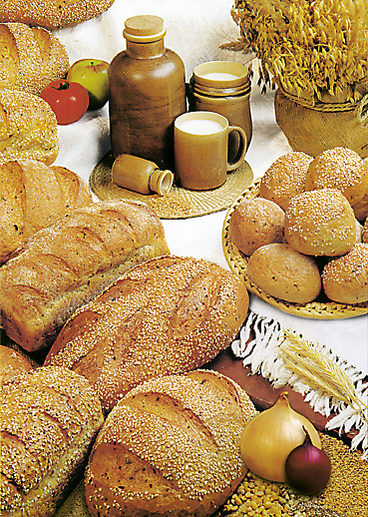
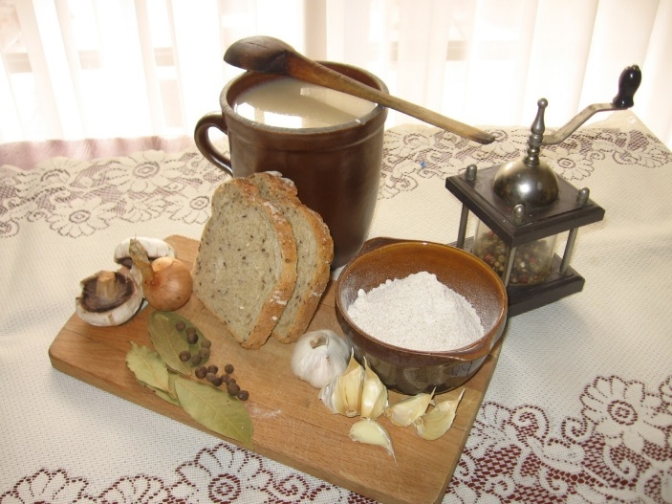
Organic grain market
growing consumer demand
need to increase organic production
quality and safety value
- nutritional value
- mycotoxin contamination prevention
technological ways of milling and baking
- wholemeal flour
- sourdough application

Slide 3
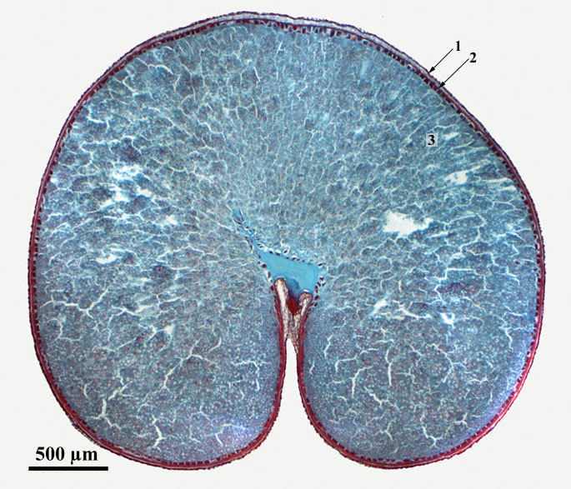
Grain structure

Slide 4
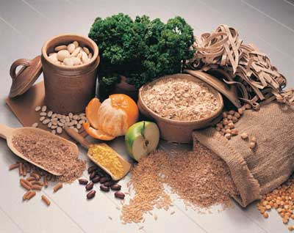
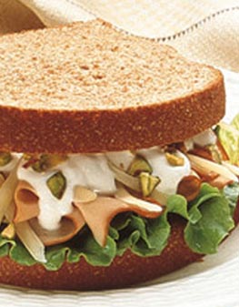
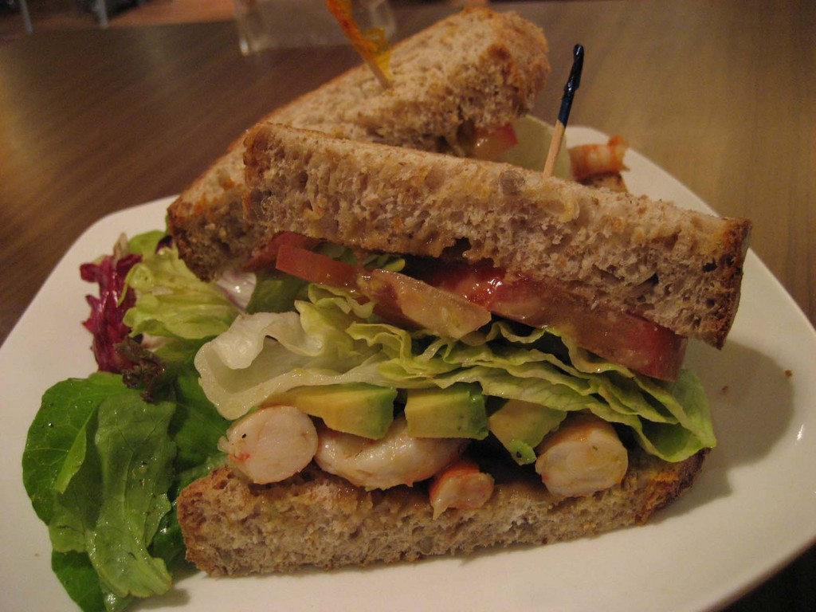
Nutritional recommendations

Slide 5
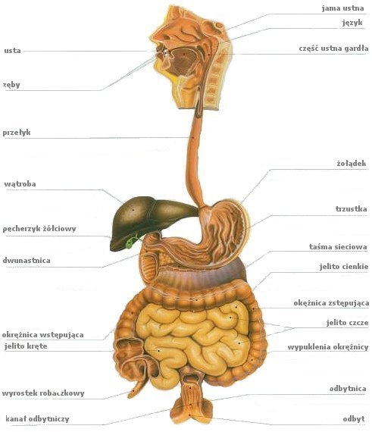
Dietary fibre
components of plants that resist human digestive enzymes
consists of non-starch polysaccharides
arabinoxylans, cellulose, resistant dextrins, inulin, waxes, chitins, pectins, beta-glucans, oligosaccharides
co-passengers:
micro- and macroelements, vitamins, antioxidants, fitohormones

Slide 6
Physiological role of DF
- enhanced mastication and saliva secretion
- buffered stomach acid
- increased satiety
- increased bulk, softened stool
- enhanced peristaltic movements
- increase in intestinal probiotics growth
- shortened transit time through the intestinal tract
- lowered cholesterol levels

Slide 7
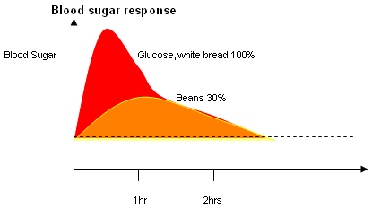
Glicaemic Index (GI)
Glucose blood level
glucose
wholemeal bread
1 h
2 h

Slide 8
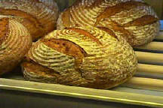
Examples of GI values:
glucose 100
potatos 93
boiled carrot 92
rice 72
wheat bread 70
wholemeal bread 53
rye sourdough bread 48
orange juice 46
*) WHO recommendation: food < 70 GI

Slide 9
Anticancer mechanism
- dilution of cancerogenous compounds in stool
(increase in stool volume)
- shortened time of cancerogens production by intestinal microflora
(shortened transition time)
- shortened contact time of cancerogens with gastro-intestinal mucosa
(shortened transition time)
- hampered degradation of some compounds into potential cancerogens
(lowered stool pH)
- protection of mucosa against cancer
(higher butyrate, lower ammonia production)

Slide 10
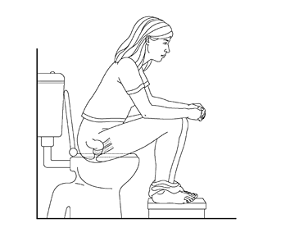
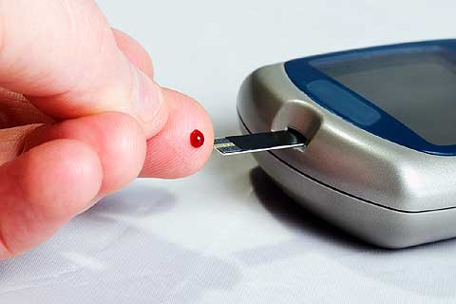
DF deficiencies lead to:
- obesity
- chronic constipation
- inflammatory bowel disease
- haemorrhoides
- colon cancer
- gallstone disease
- inflammation of the appendix
- diabetes
- arteriosclerosis
- coronary heart disease
- dental caries

Slide 11
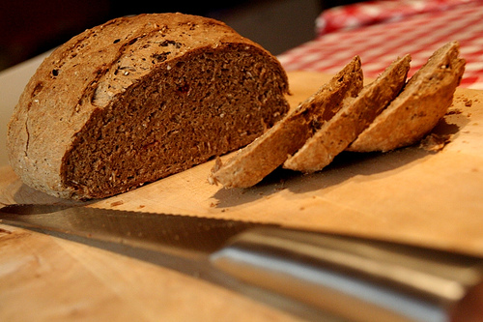
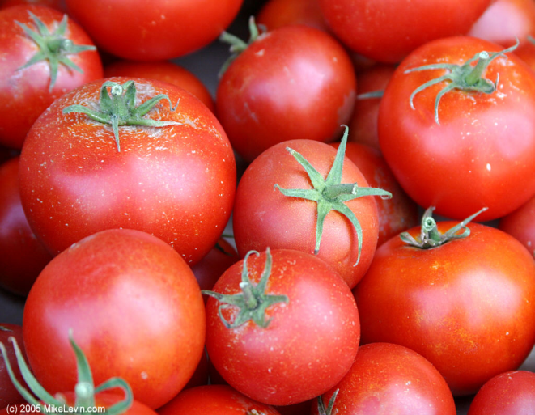
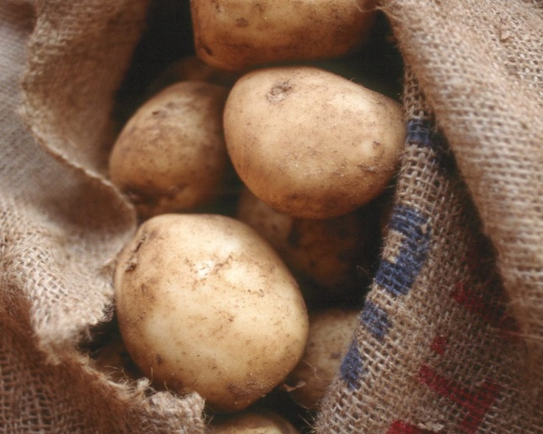
Sources of dietary fibre
6-9 slices = 7 kg = 2 kg

Slide 12
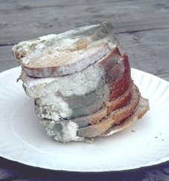
Mycotoxins – health hazard
Moulds:
Aspergillus
Penicillium
Fusarium

Slide 13
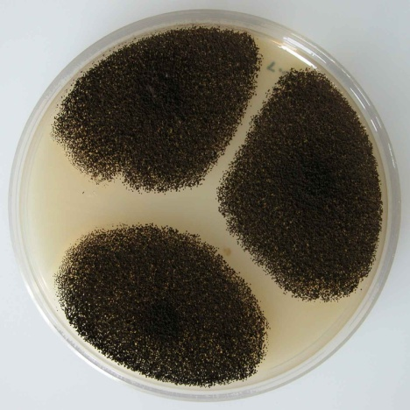
Mycotoxins
aflatoxins B₁, B₂, G₁, G₂ (A.flavus, A.parasiticus)
esophagus cancer, liver/kindneys damage
ochratoxin A (A.ochraceus, Penicillium)
cancerogenic, teratogenic, nephropathy
trichotecen (Fusarium)
esophagus/stomch cancer
zearalenon (Fusarium)
estrogenic

Slide 14
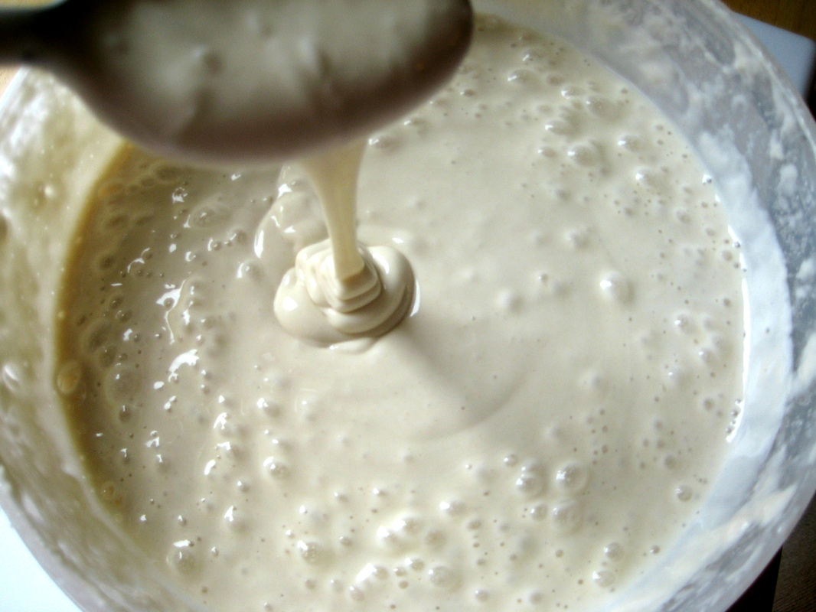
Sourdough
a mixture of flour and water fermented with lactic acid bacteria (LAB) and yeast

Slide 15
Lactic acid bacteria
crumb elasticity
bread flavour
bread volume
Yeast
bread volume
bread flavour

Slide 16
Biopreservation of sourdough bread
STRAIN
Lactobacillus plantarum
Lactobacillus sanfranciscensis
Lb.plantarum
+
Lb.sanfranciscensis
Lb.plantarum
X
-
-
Legend:
+ + +
strong restraining effect ( diameter > 4 cm )
+ +
medium restraining effect ( diameter 2 - 4 cm )
+
weak restraining effect ( diamerer < 2 cm )
-
no restraining effect
Lb.sanfransiscensis
-
X
-
Lb.brevis
-
-
-
S.cerevisiae
+
+
+
E.coli
+ +
+ +
+ + +
E.faecalis
+ +
+ +
+ +
B.cereus
+ + +
+ + +
+ + +
B.subtilis
+ +
+ +
+ + +
A.niger
-
-
-
P.expansum
+ +
+ +
+ +
F.oxysporum
+ +
+ +
+ + +
R.nigricans
+
-
+

Slide 17
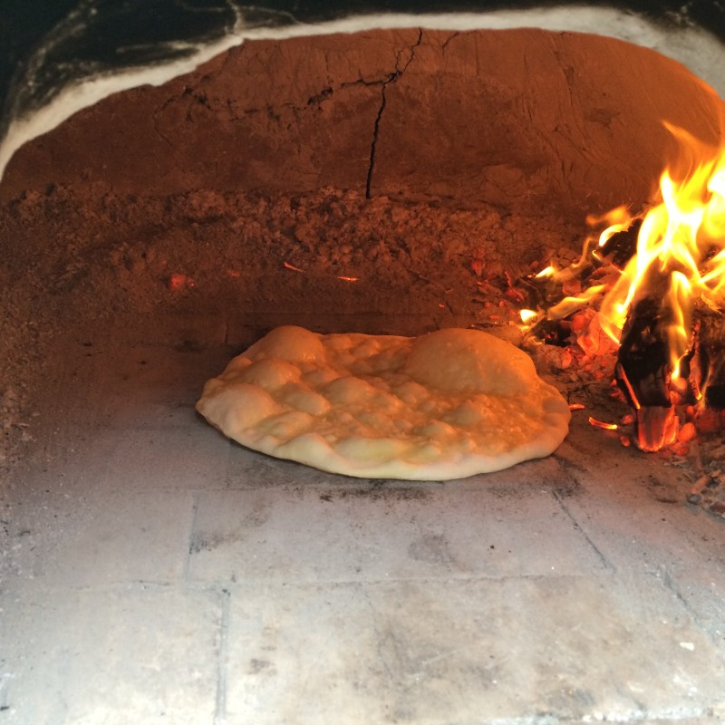
4000 B.C. – first forms of bread

Slide 18
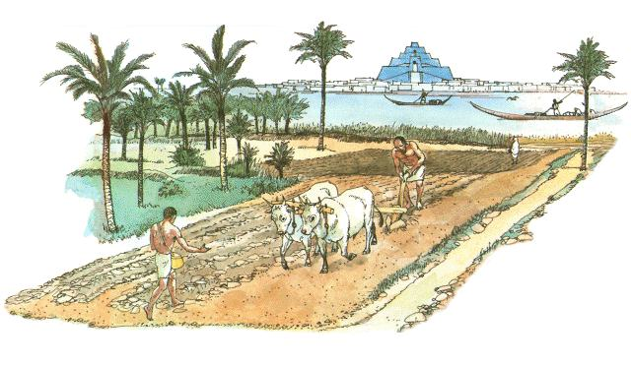
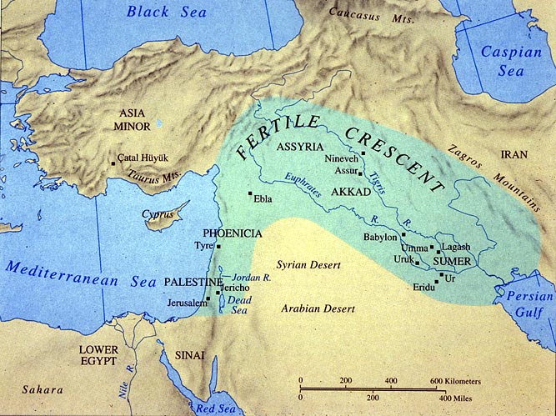
Sourdough bread history
3000 B.C. – Sumerians (?)

Slide 19
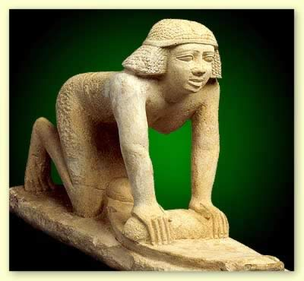
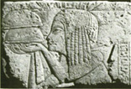
2600 B.C. – ancient Egypt

Slide 20
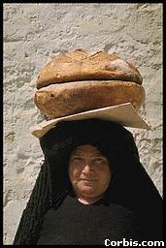
1800 B.C. – Mediterranean region
1300 B.C. (?) – Jewish exodus from Egypt

Slide 21
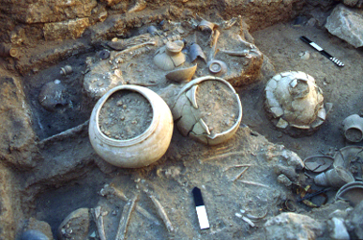
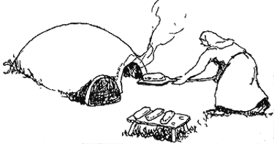
800 B.C. – North & Central Europe
100 B.C. – worldwide

Slide 22
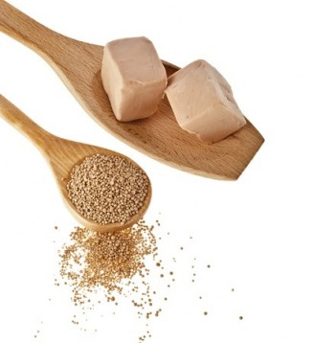
middle of 19th century – baker’s yeast

Slide 23
Traditional rye sourdough fermentation
1st stage – initial sour (48-72 h)
enhanced growth of existing microflora; inhibition in growth of spoilage bacteria
(soft dough - flour to water ratio 1 : 1, temperature 22-24°C);
2nd stage – fresh sour (4-6 h)
growth of yeast (soft dough, temperature 24-26°C);
3rd stage – basic sour (6 h)
growth of LAB (dense dough, temperature 26-29°C);
4th stage – full sour (3 h)
intensive growth of LAB and yeast (soft dough, temperature 27-30°C);
5th stage – dough (20 min)
final stage, containing all ingredients according to the recipe
(consistency proper for shaping and proofing, temperature 30-32°C).

Slide 24
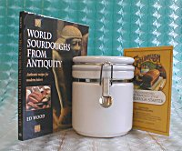
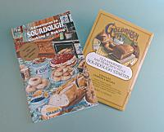
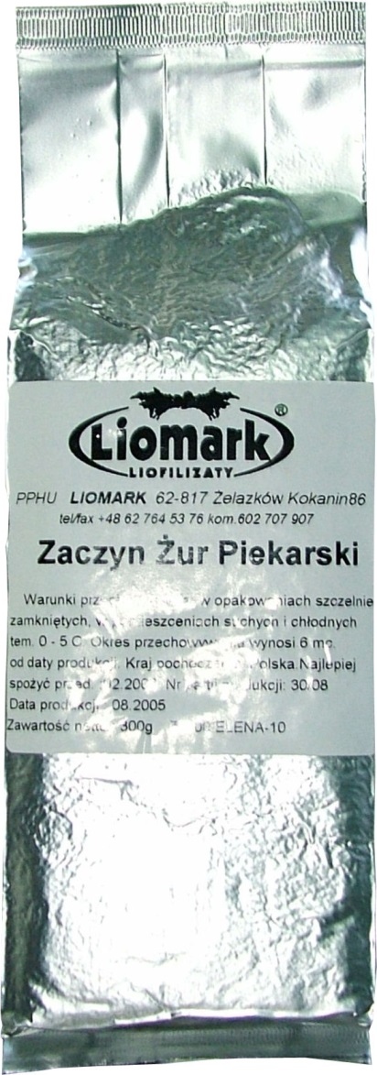
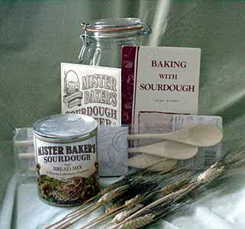
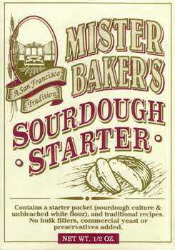
Bakery starter cultures

Slide 25
Role of bakery starter culture
initiation of the fermentation process
obtaining the desired baking parameters of the dough due to the biochemical changes in fermented flour
stability of the fermentation process
shortening and simplifying sourdough production
obtaining the unique and very attractive taste and flavour of the bread
bread of high nutritional value
reduction or elimination of artificial improvers and preservatives
repeatability of bread quality
prolonged shelf life of sourdough bread

Slide 26
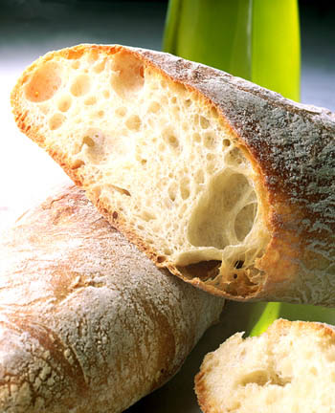
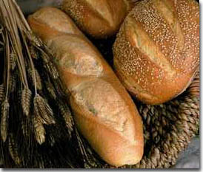
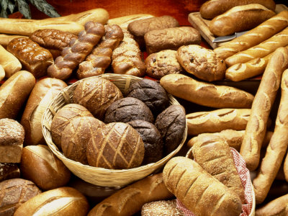
Diversity of sourdough bread

Slide 27
Health benefits of sourdough bread
degradation of mycotoxins present in flour
initiation of numerous physiological processes to promote digestion
increased digestibility by enzymatic processes performed during fermentation
satiety is achieved faster (low glycaemic index)
ensurance of the proper course of digestion and excretion (lactic acid)
lowered immunoreactivity
preservation of bioactive labile compounds
(vitamins, plant sterols or β-glucan)
elimination of some antinutrients
(phytic acid and its derivatives)
lowered serum triglyceride and cholesterol levels, improved ratio between HDL and LDL fractions

Slide 28
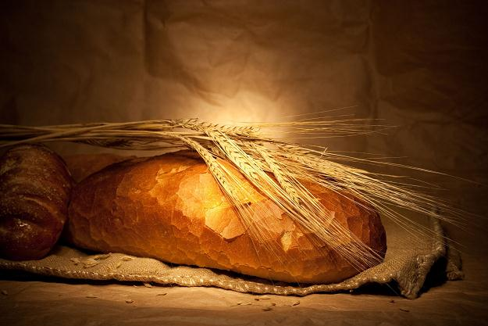
C O N C L U S I O N
Modern sourdough technology combines
all advantages of tradition and artisan production with scientific achievements
giving the possibility to minimise risk of mycotoxins
in ecological bread production

Slide 29
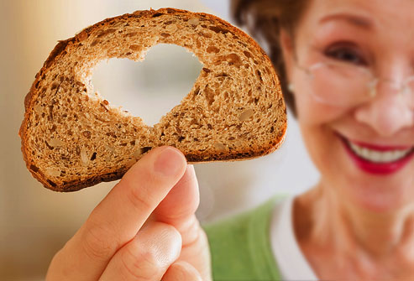
Thank you for attention

