Slide 1
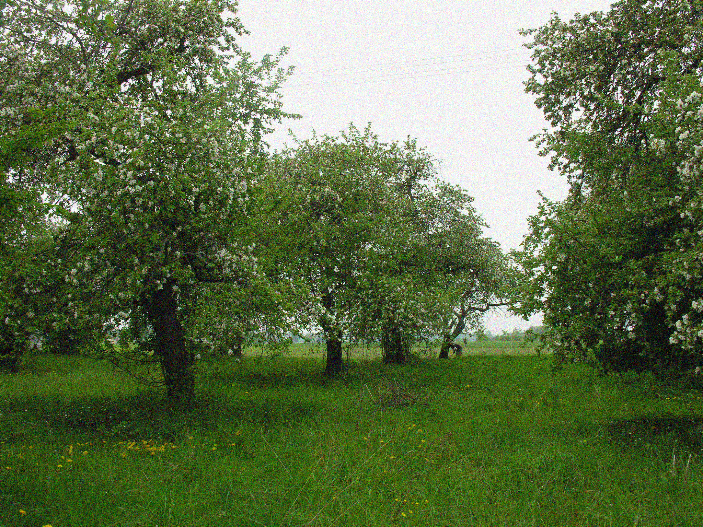
Traditional Orchards
Organic Farms
AgriNatura Foundation
www.agrinatura.pl

Slide 2
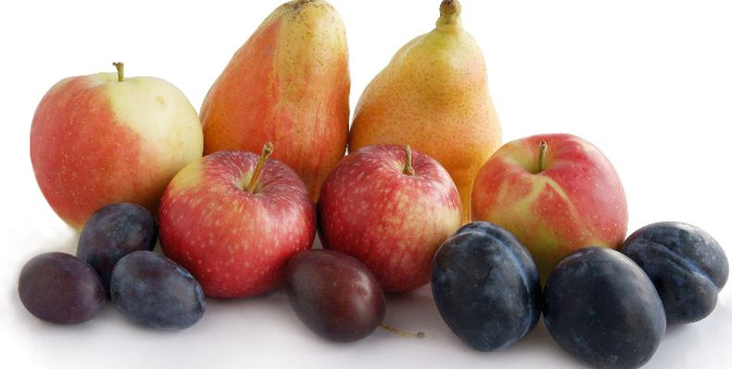
Traditional orchards in Poland
The history of traditional orchards in Poland dates back to the 11th century. At that time Benedictine monks arrived in Poland, bringing in initial varieties of fruit trees. The Benedictine monastery in Tyniec (near Krakow – south Poland) became a center of agriculture. Its abbot, described as “the abbot of a hundred villages”, owned a lot of land, on which priests had planted apple- and pear trees, which from there spread across Mazovia and Prussia (Central and North Poland).
Soon gardens with fruit trees were established in other order's monasteries, castles, manors and peasants' farms. This marks the appearance of standard trees in home- or traditional orchards in rural Polish landscapes. Their development was particularly improved during 18th, 19th and partially 20th century. At that time Polish rural landscapes were characterise by flowering fruit trees. Fruit processing became an important part of culinary habits.

Slide 3
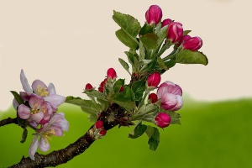
Foundation for Agricultural Biological Diversity
AgriNatura
Foundation year 2007
the headquarters are located in an ecological farm in the village of Świerże-Panki (Ostrów Mazowiecka poviat, Mazowieckie Region).
Objectives:
sustainable development of rural areas, in particular protection and multiplication of genetic resources and agricultural biodiversity;
development of ecological and biodynamic methods of agricultural production, and local processing and product coming from them;
development of civil society in rural areas.

Slide 4
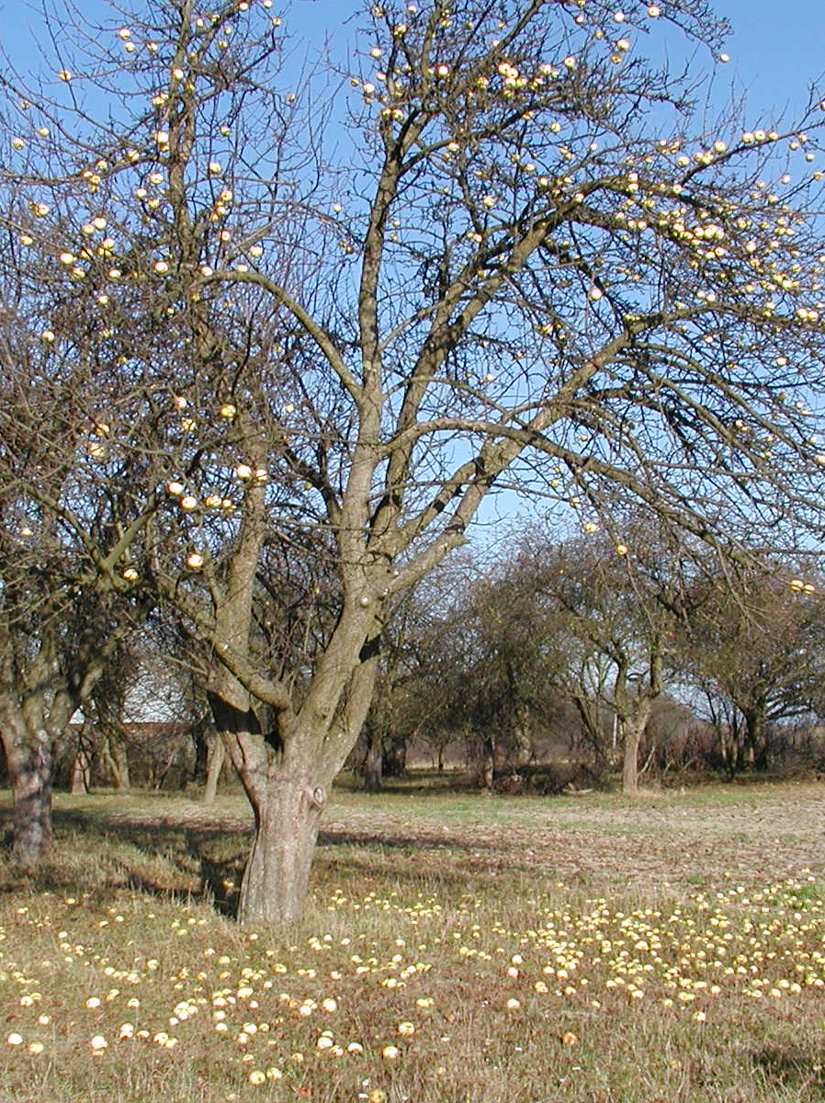
Traditional orchards have special functions in the rural landscape.
They create a microclimate around farm buildings, stop water and wind erosion.
They are a place of life for many small
animals, birds, insects and butterflies.
They do not need chemical protection practically.
They generally consist of species trees
and well-adapted varieties to environmental conditions that are resistant to disease.
As a result of the long duration and lack
of chemical interference, a balance between populations was created in them pests
and beneficial organisms.
Thanks to this, the pests slightly they
only affect the size and quality of fruit yield.

Slide 5
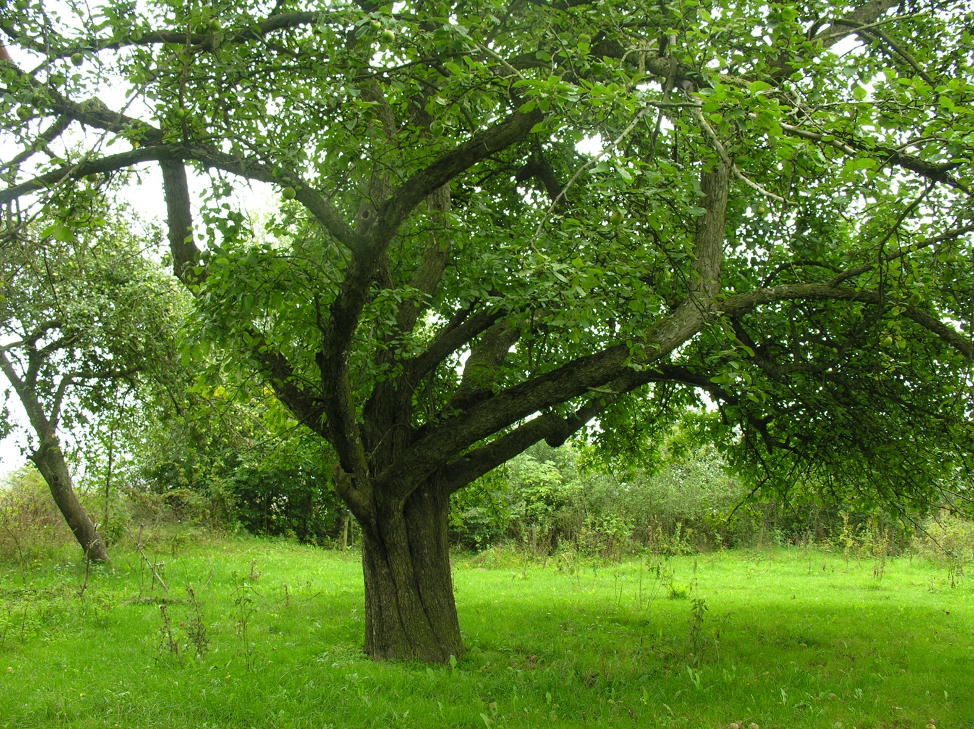
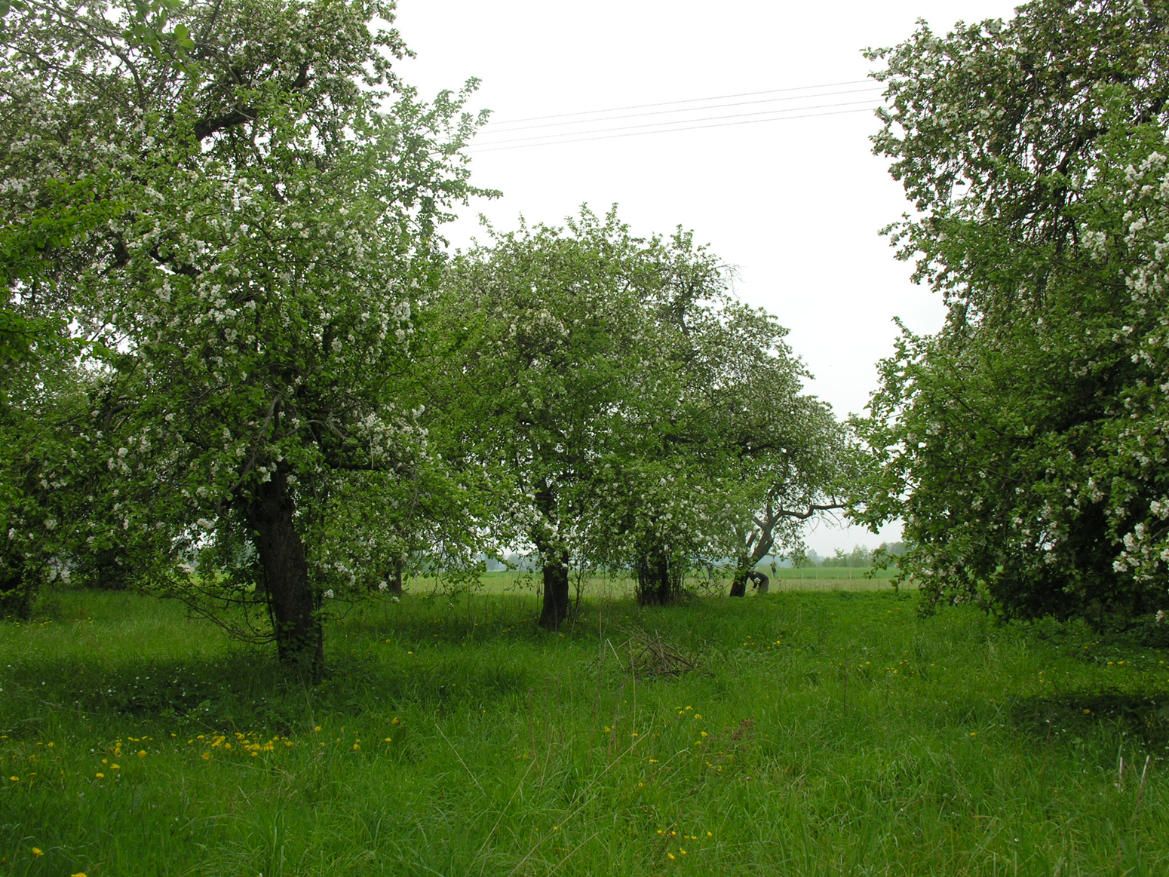
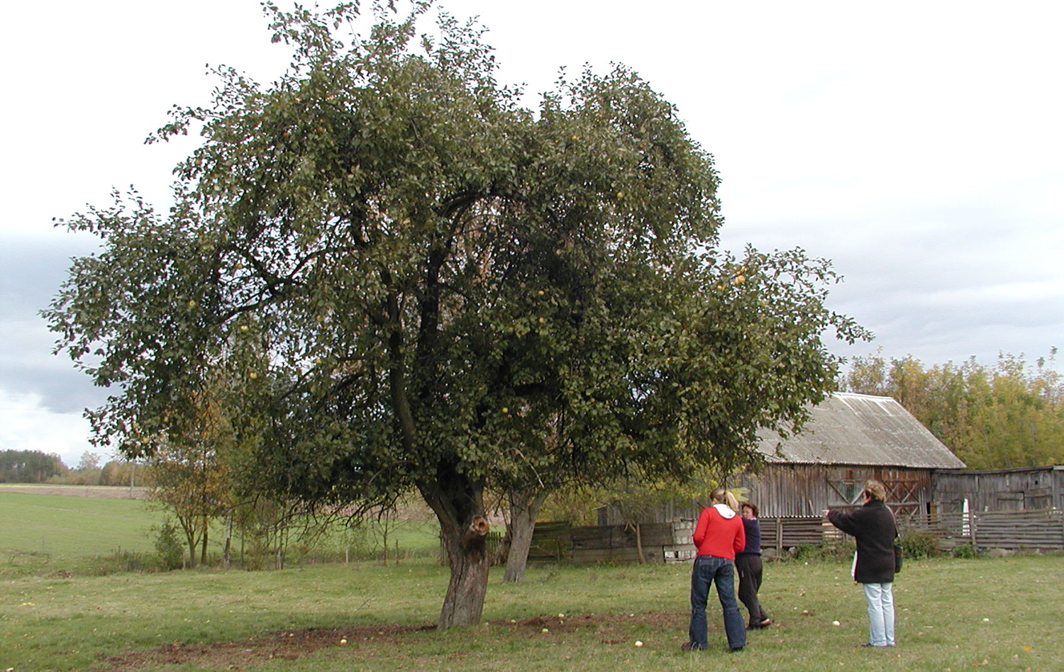
Tall-growing fruit trees they play the role of a rich ecosystem.
One hectare old orchard makes him stay
in this area more than 10 species of birds more, and plants and insects more than 100 species.

Slide 6
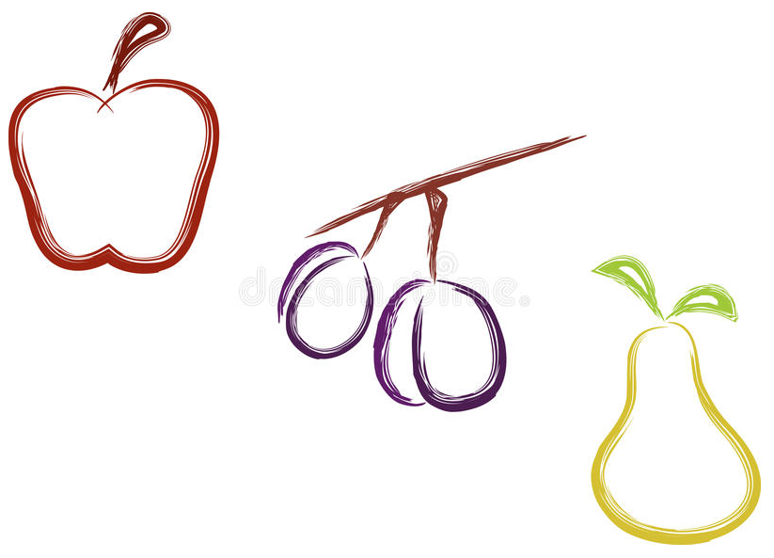
The AgriNatura Foundation and the Social Ecological Institute set up new traditional orchards since 2005.
As part of these projects, orchards were created next to municipal schools, landscape parks, agricultural advisory centers and individual farms.
Founded, among others:
Collections
Regional - places
Education and Live
Banks Genes

Slide 7
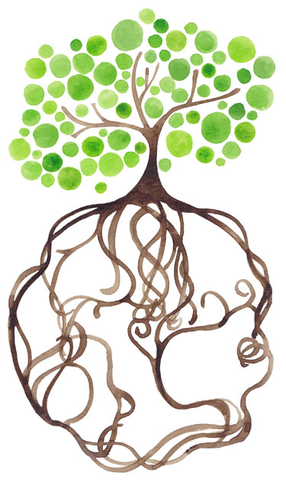
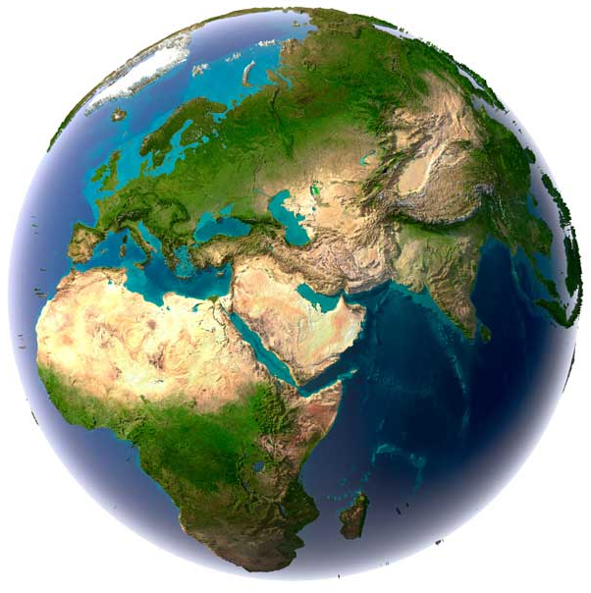
Since 2015, the PUR PROJECT program "We plant trees for the planet" is a new project for the reconstruction of traditional orchards in Poland.
In 2015 and 2016, 6,500 trees were planted.
In 2017, 8,000 trees were planted.

Slide 8
Recruitment:
In order to promote the idea of traditional orchards, AgriNatura Foundation cooperates with:
Local NGOs
Agricultural advisory centers
Local administration
Parishes
Botanical gardens and open-air museums
Landscape parks
AgriNatura team is in direct contact with each person chosen to participate in the project.
The orchard plan is created after getting to know the terrain, environmental conditions, possibilities and needs of the owner.
An individual planting plan is created for each site.

Slide 9
Conditions of participation:
Area for planting at least 50 trees at intervals of 5x6 m (ca 0.25 sq m);
Area fencing - protection against wild animals;
Signing a cooperation agreement with the foundation;
Completing the appropriate forms;
Consent for orchard monitoring for two years after the establishment of the orchard.

Slide 10
The AgriNatura Foundation is committed to
Purchase of trees;
Conducting training on traditional orchards: how to plan an orchard, how to plant, how to form and cultivate young trees;
Elaboration of the planting plan agreed with the farmer / land owner.
The farmer / owner is committed to
Participation in training;
Appropriate land preparation;
Area fencing;
Planting trees according to plan;
Proper care.

Slide 11
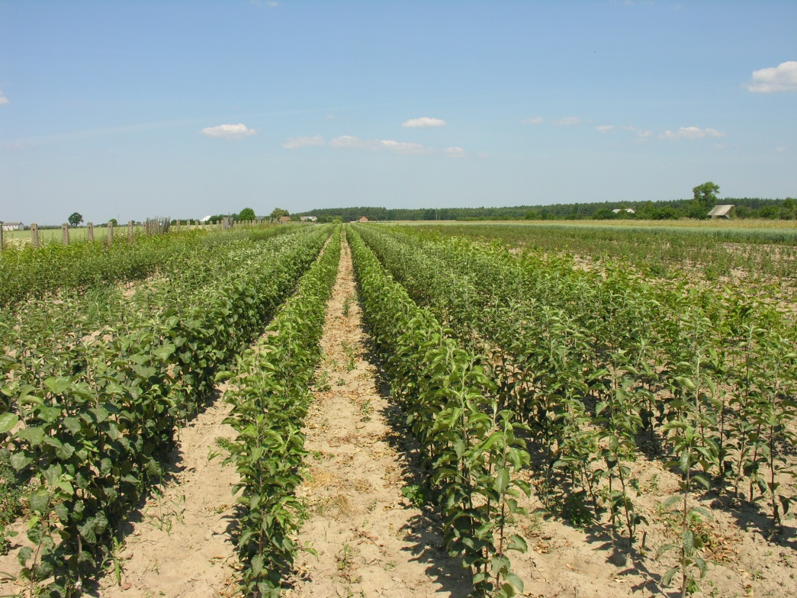
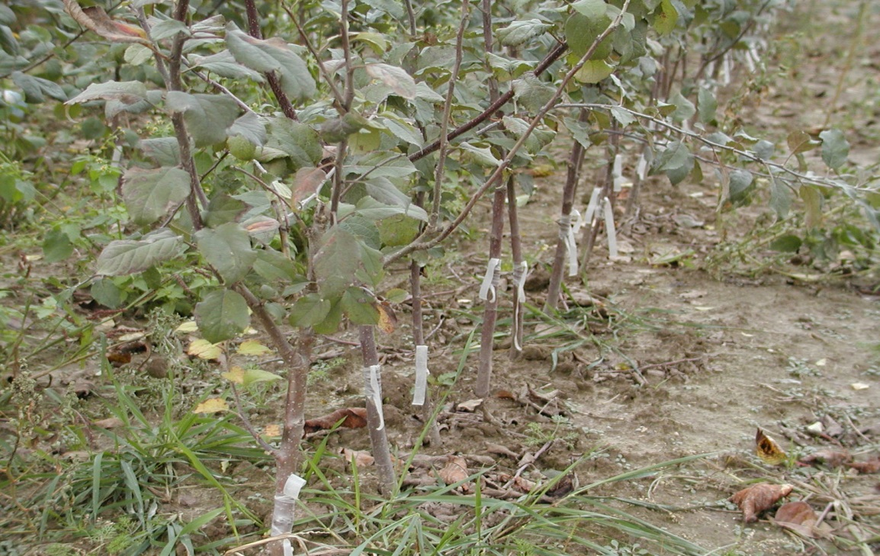
The trees come from the nursery of old varieties in Kruszewo (Goworowo commune).
The nursery specializes
in the production of tall-growing trees.

Slide 12
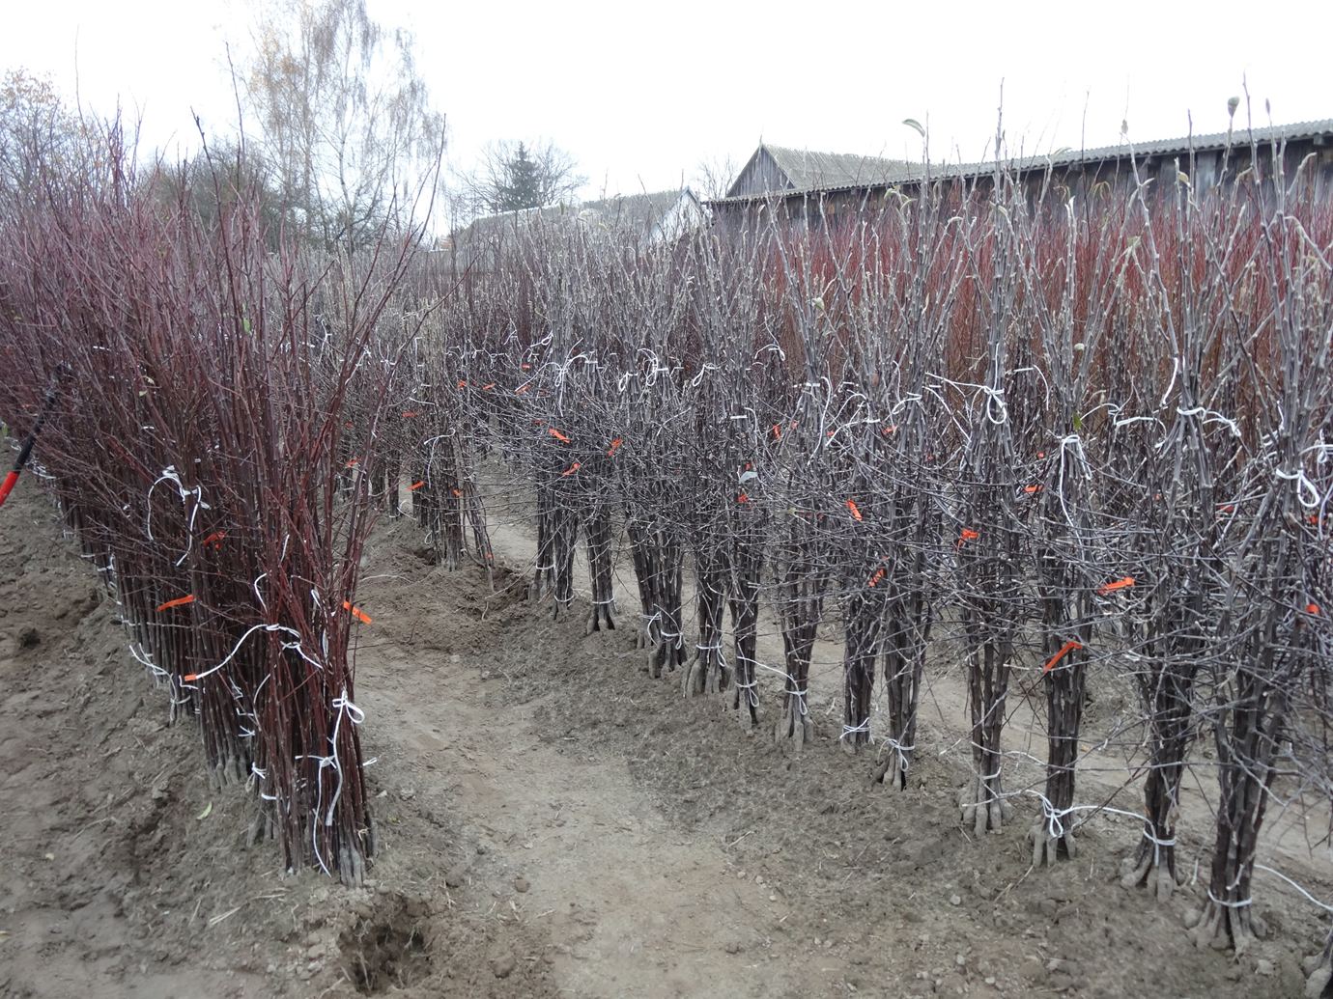
In autumn, the trees are prepared for transport.

Slide 13
WORKSHOPS
Each consists of two parts:
I. Theoretical part:
The ecosystem of rural areas (how to protect and how to multiply agricultural biodiversity);
Traditional Polish varieties of fruit trees;
How to set up a new traditional orchard (choice of place, selection of varieties, soil preparation, etc.);
Care of a young orchard - fertilization, cutting, ecological protection against pests, etc.);
Fruit processing.

Slide 14
WORKSHOPS
II. Practical part:
How to prepare the area according to the plan;
How to plant a tree;
How to protect a tree;
How to cut and form the crowns of young trees.

Slide 15
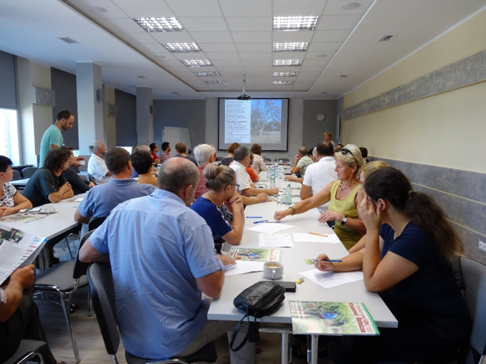
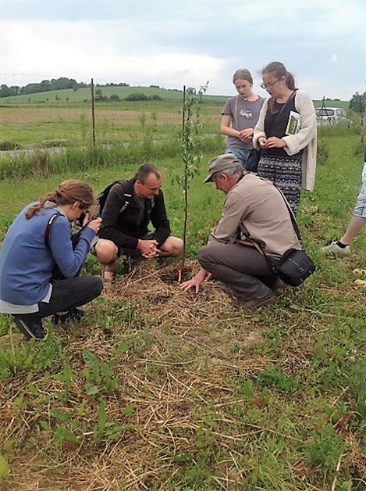
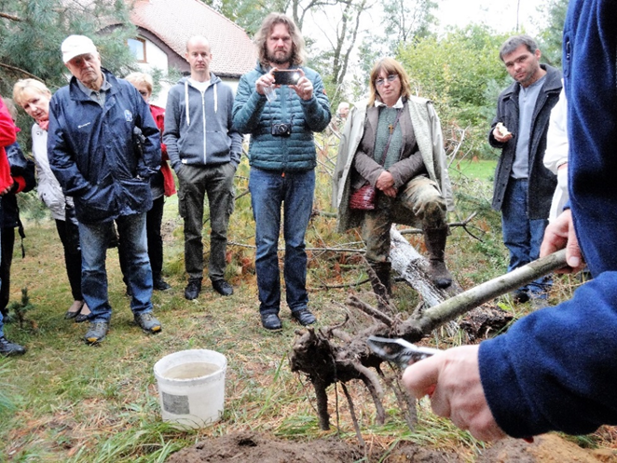
In 2016, 14 workshops took place – in the picture: ODR Boguchwała; Eco-village in Opole; workshop in Cisza /comune Kluki – Lodzkie Region/

Slide 16
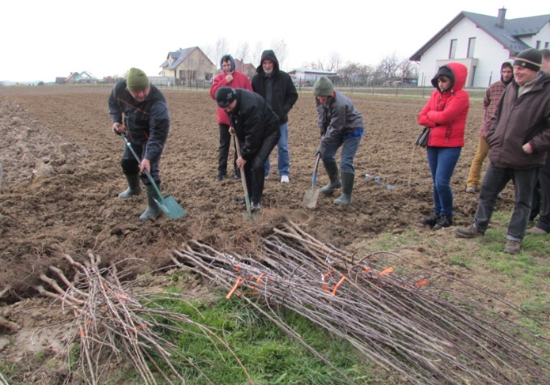
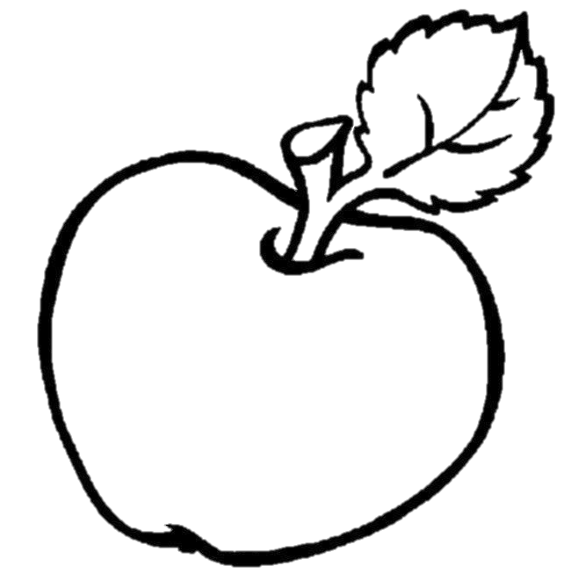
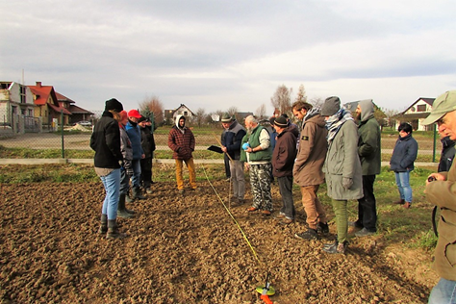
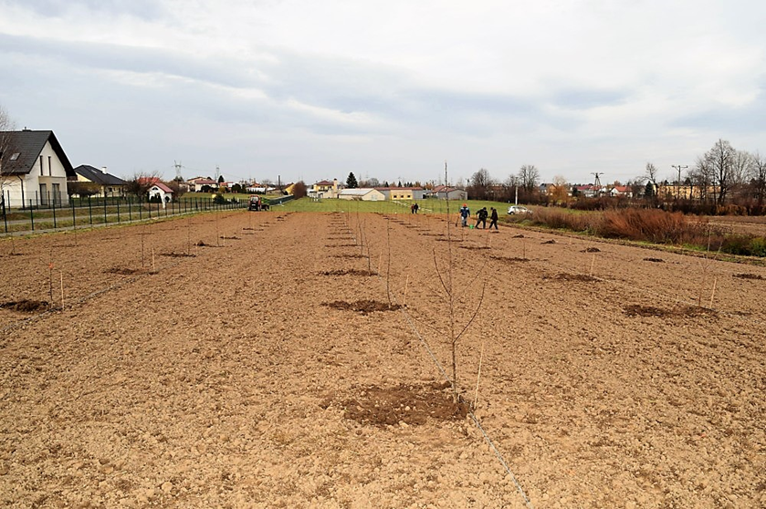
Field work, measurements
&
plantings…

Slide 17
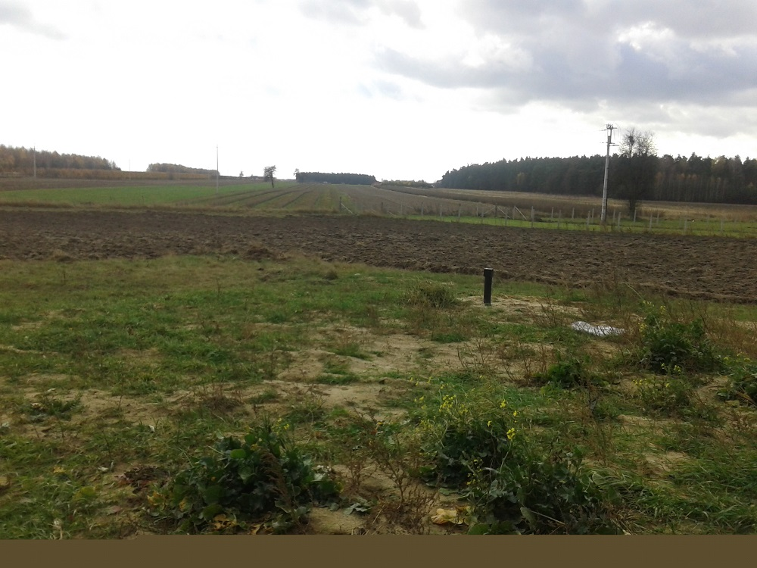
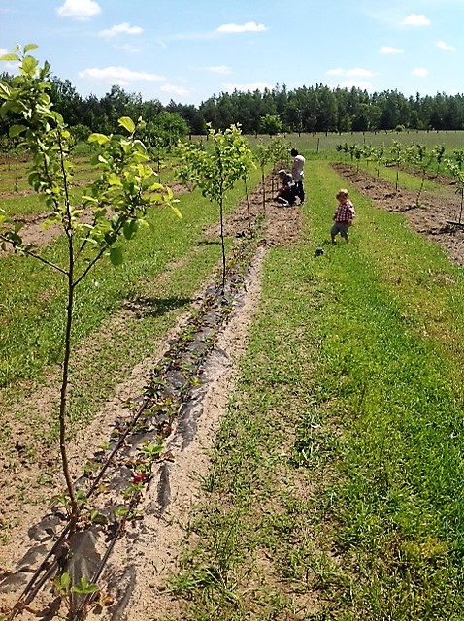
A spectacular change…

Slide 18
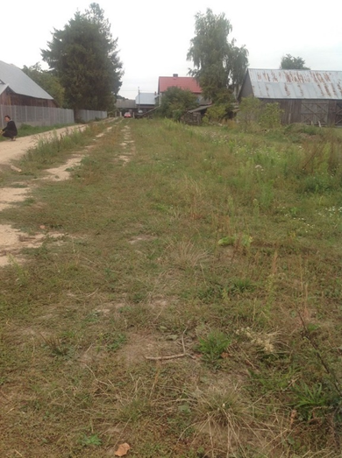
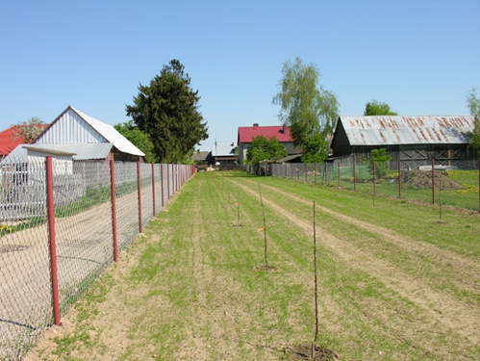
A new landscape view…

Slide 19
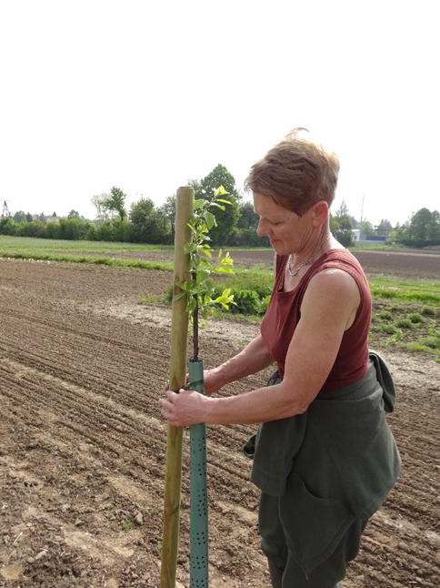
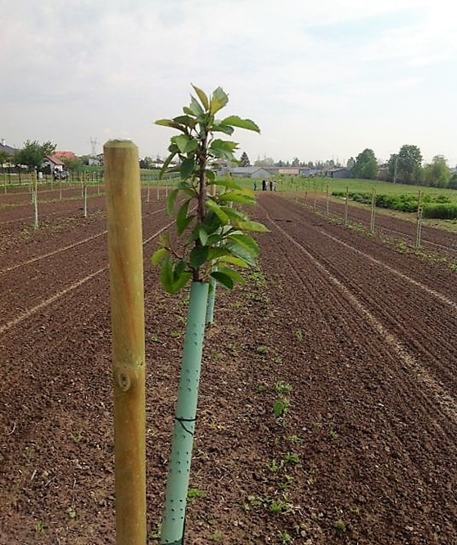
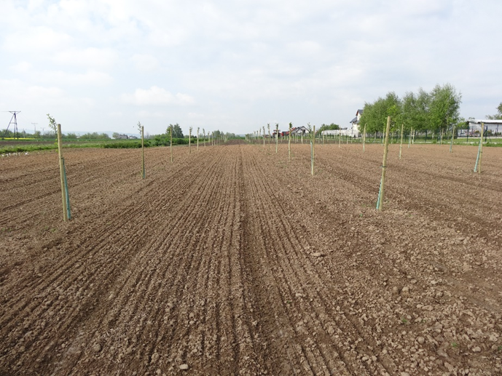
A model traditional orchard at ODR Boguchwała - a place of education for farmers from Podkarpacie Region.

Slide 20
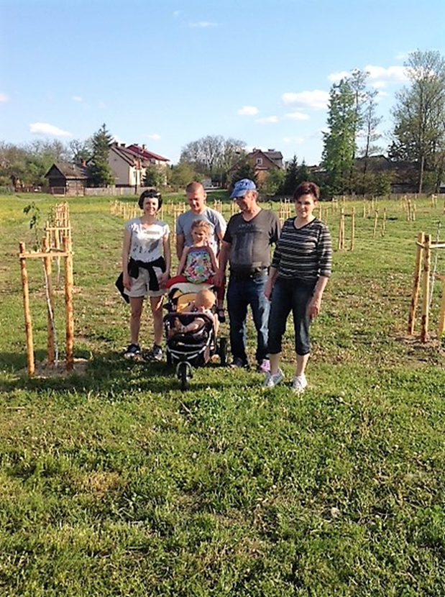
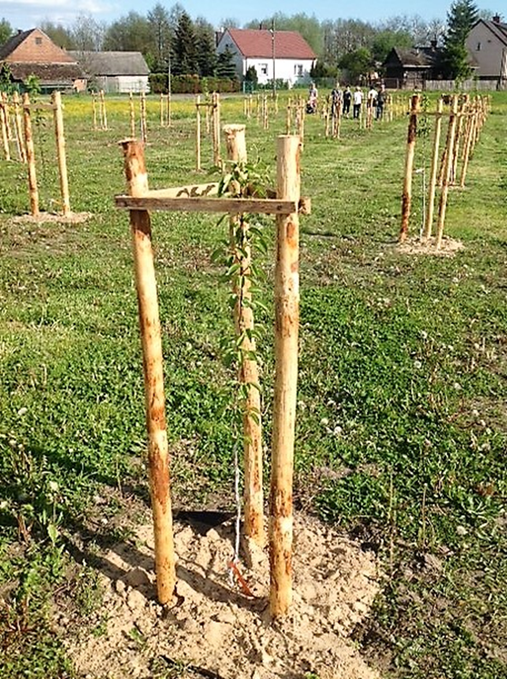
Traditional orchard in the center of Woliny – the property of the residents of the village: a place for meetings and talks about nature, ecology, culinary and tradition.

Slide 21
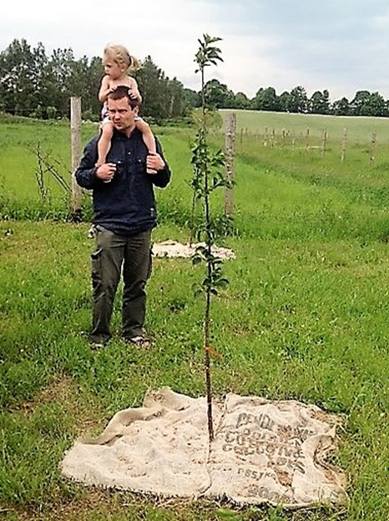
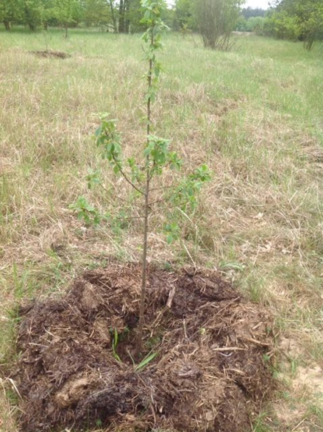
Traditional orchards carried out using the permaculture method: an ecological village in Opole and Gapinin.

Slide 22
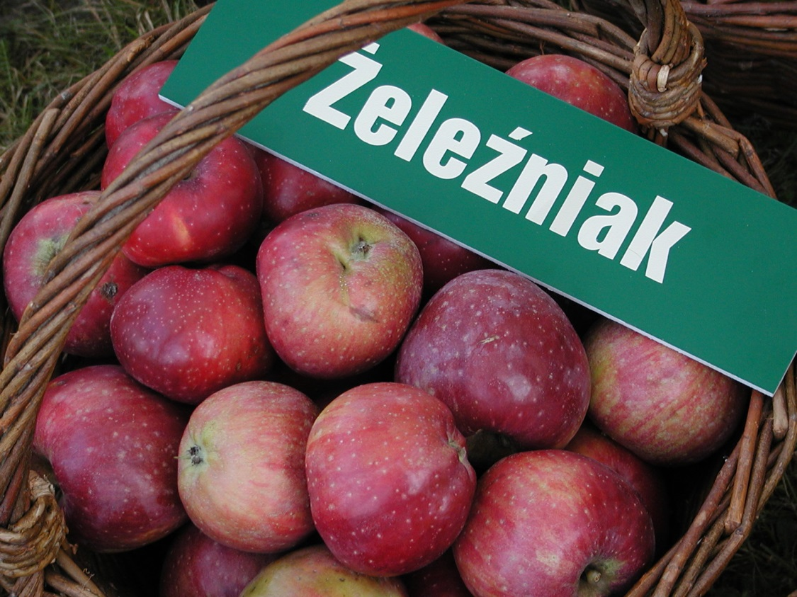
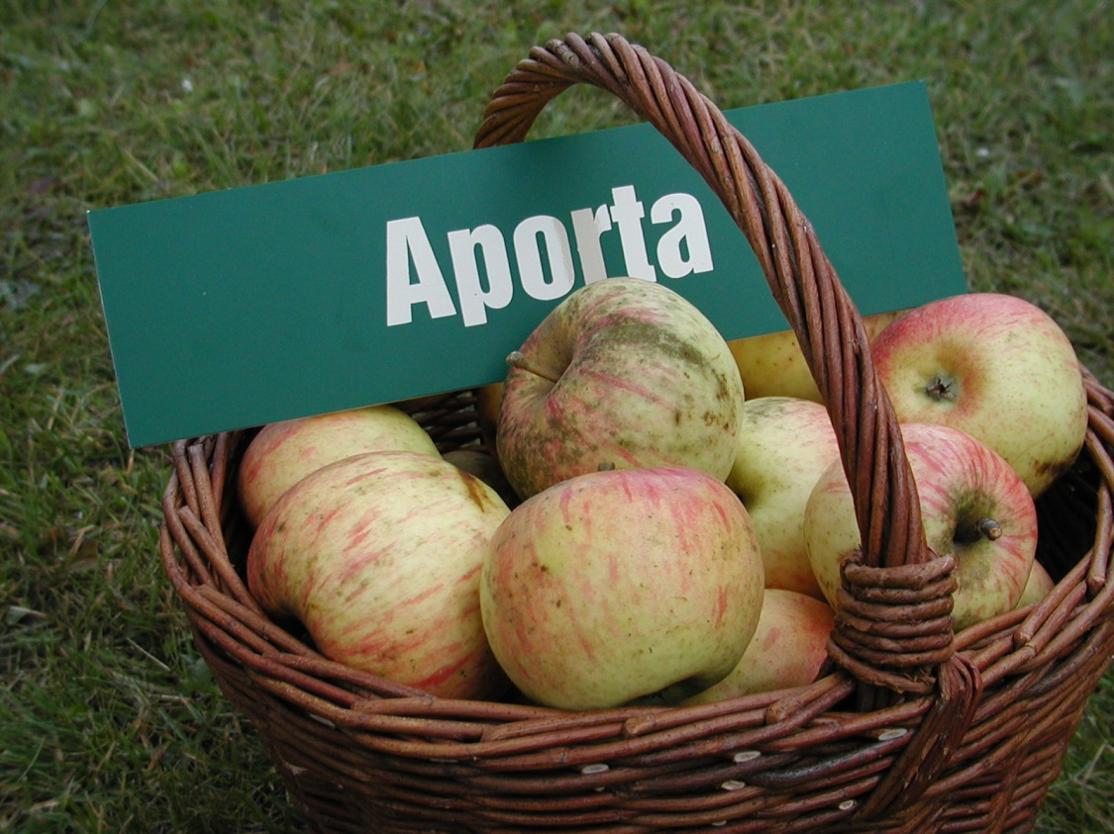
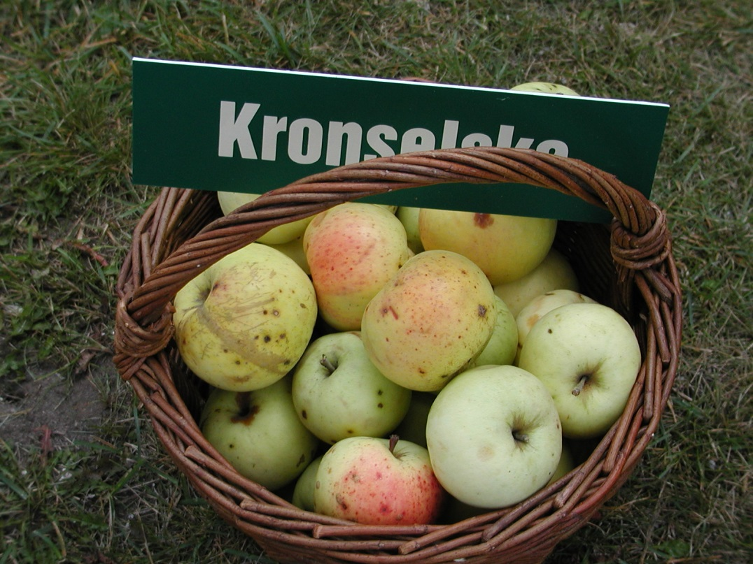
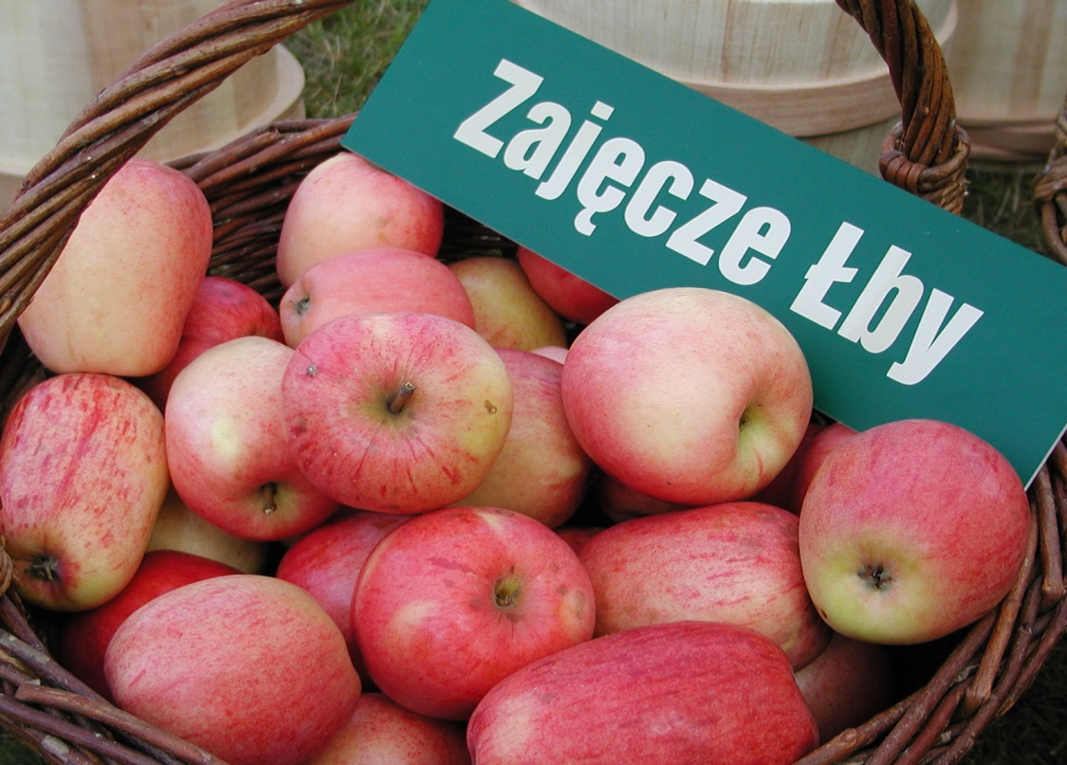

Slide 23
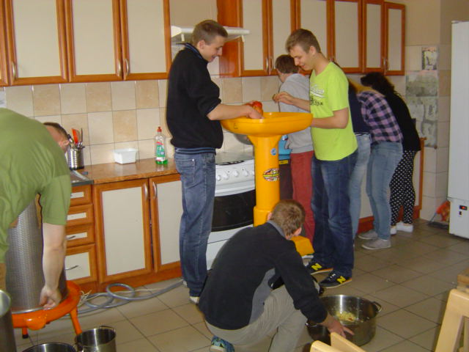
Involvement in fruit progress…

Slide 24
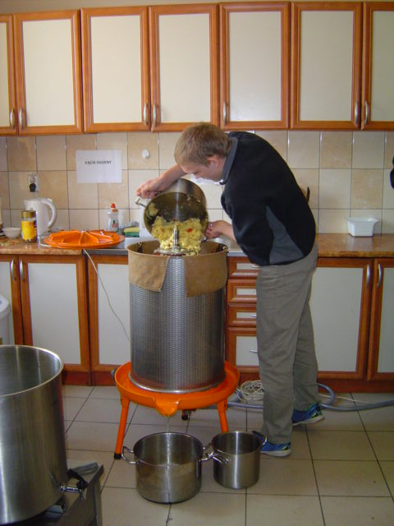
1. Pressing juice…

Slide 25
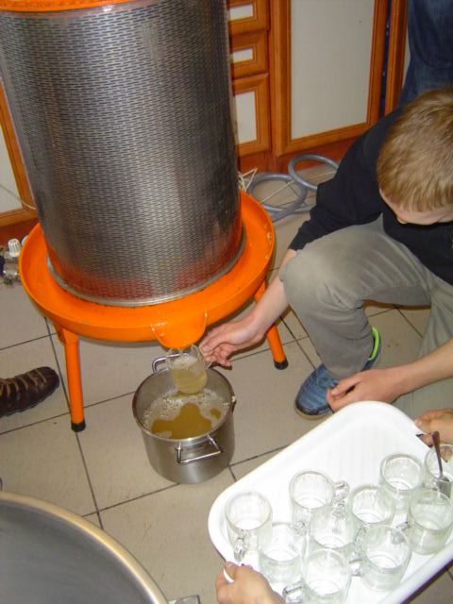
2. Delicious, gold
&
healthy juice...

Slide 26
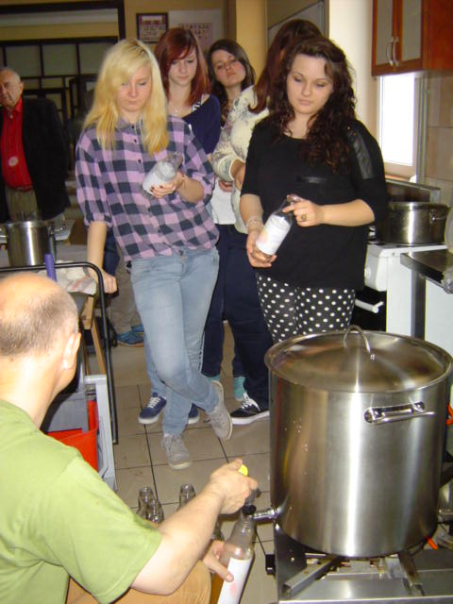
3. Bottling
in progress...

Slide 27
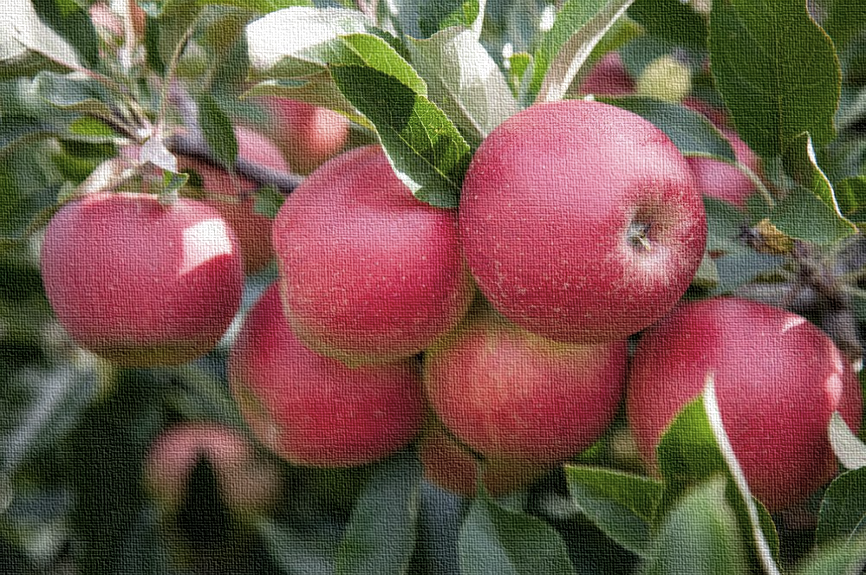
www.esto-project.eu

Slide 28
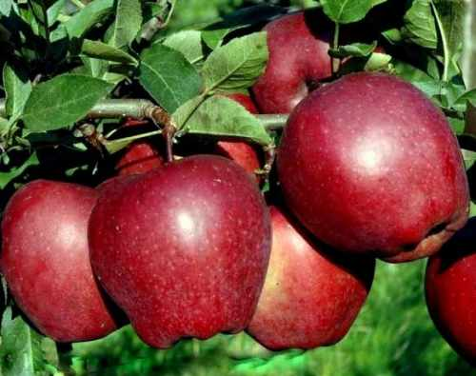
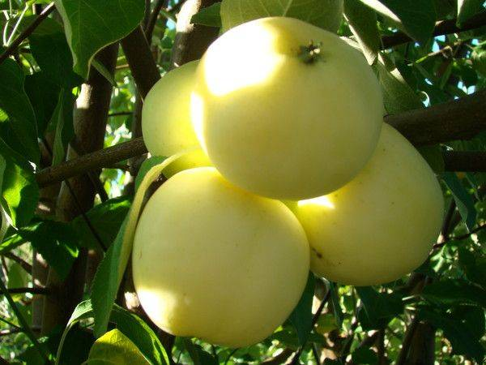
Thank You
very much
for Your attention!
Artur Kurzeja
arturxyz@vp.pl

