Slide 1
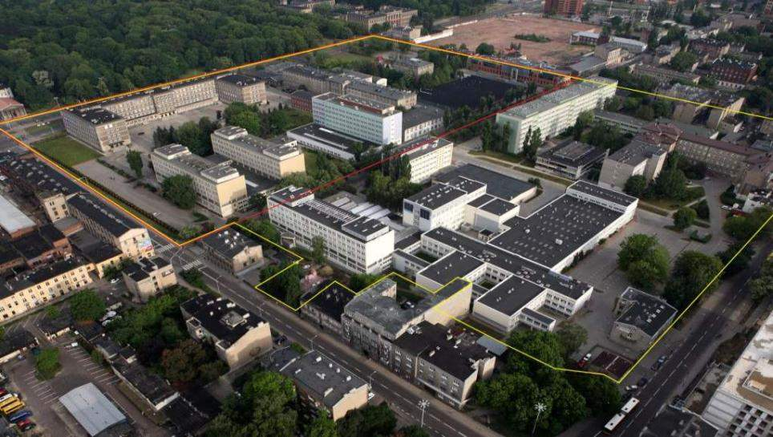
UNIVERSITY CAMPUS – Biotechnology and Food Sciences

Slide 2
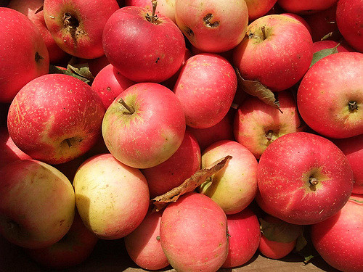
BSc and MSc degrees
BIOTECHNOLOGY
FOOD TECHNOLOGY and HUMAN NUTRITION
ENVIRONMENTAL PROTECTION
Molecular Biotechnology and Technical Biochemistry
Food Biotechnology
Technology of Fruit and Vegetable Products
Technology of Vitamins and Food Concentrates
Fermentation Technology and Microbiology
FermentationTechnology
Technical Microbiology
Technology of Spirit and Yeast
Environmental Biotechnology
Food Technology
Technology of Food Refrigeration
Technology of Sugar Production
Technology of Confectionery and Starch
Food Analysis and Quality Evaluation.
Environmental Biotechnology
COSMETICS TECHNOLOGY
Cosmetics Technology
Food Chemistry and Cosmetic Raw Materials
Food Chemistry
Food Aromas and Cosmetic Raw Materials

Slide 3
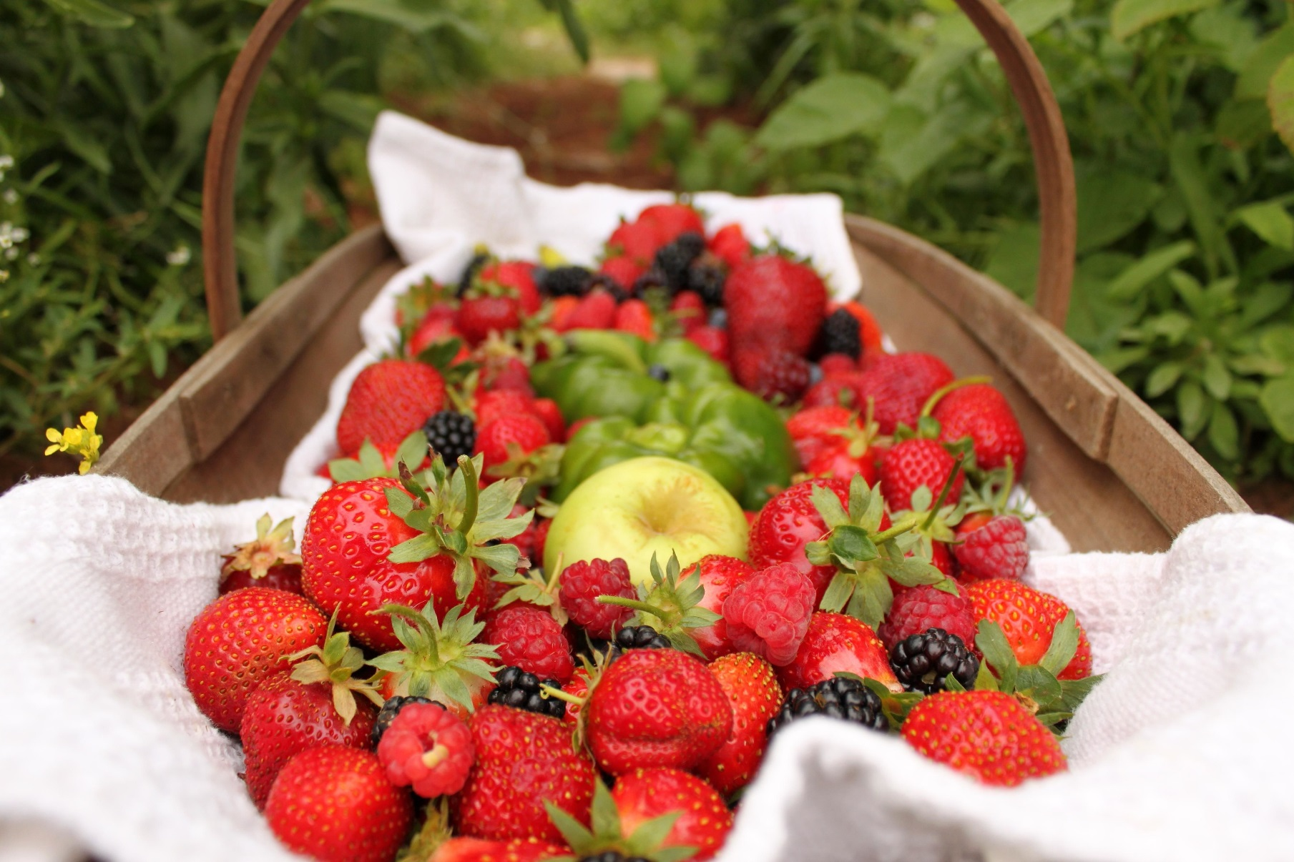
FACULTY in NUMBERS
Current number of students
1292 students on both cycles
92 PhD students
Academic stuff includes
83 teachers
10 professors
30 associate professors
Total awardnes at Faculty
9974 MSc degrees
415 PhD degrees
57 DSc degrees
Notes:
Uaktualnic dane

Slide 4
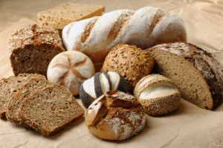
RESEARCH AREAS IN FOOD SCIENCES

Slide 5
THE INSTITUTE OF GENERAL FOOD CHEMISTRY
Biosensors for food analysis

Slide 6
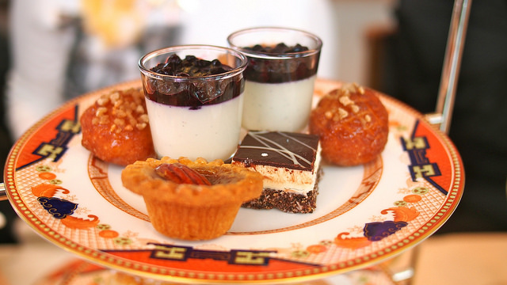
Institute of Fermentation Technology
and Microbiology
FOOD BIOCHEMISTRY
Analysis of bioactive phytochemicals
Determiantion of antioxidant activity
Evaluation of bioavailability in vitro
NUTRIGENOMICS
Regulation of gene expression by bioactive diet components

Slide 7
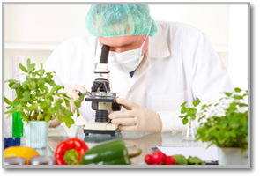
INSTITUTE of TECHNOLOGY
and FOOD ANALYSIS
Evaluation of quality and functional properties of food
Alternative food and feed products of sugar beet
Food Quality Proficiency Tests

Slide 8
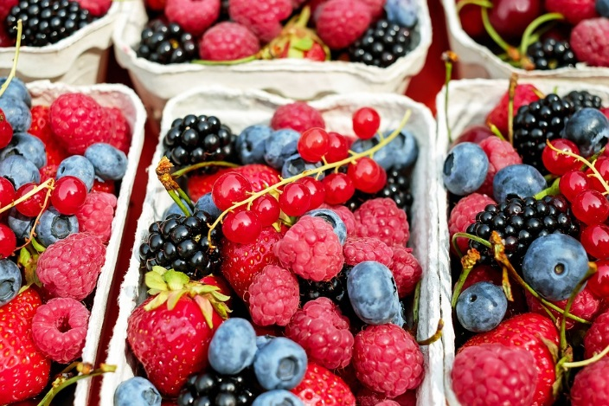
OUR FUTURE

