Slide 1
Perspectives for circular economy in alentejo
European week of regions and cities
The circular economy and the new entrepreneurial
And social revolution
9- 12 october 2017 - brussels
VASCO Fitas da Cruz
Rural Engineering Department, Évora University, Portugal
vfc@uevora.pt

Slide 2
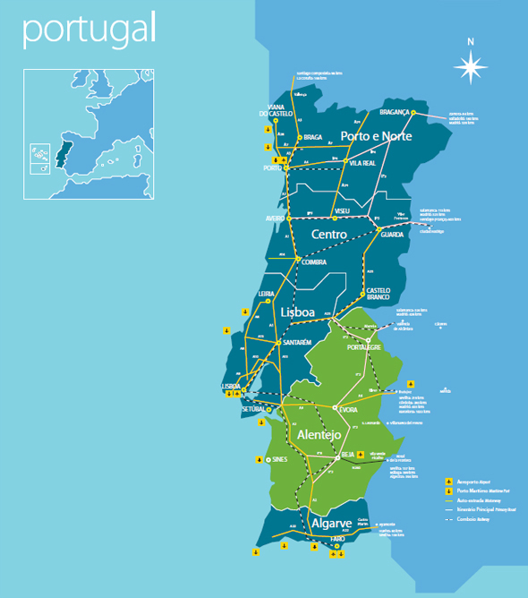
ALENTEJO:
One third of the national territory
Important border Iine with the Spanish regions of Andaluzia
and Extremadura and also an extensive Atlantic coast line
of 170 km
More than 25% of the Alentejo territory includes sites
of Special Protection Areas (Natura2000)
Dynamic business in new productive sectors, especially
the manufacturing industry, tourism, new emerging
technologies as renewable energy

Slide 3
ALENTEJO:
In recent years the traditional agricultural and agri-food structure has been gradually change as result of the multipurpose development enterprise of Alqueva.
The export profile of the region relies on recovery activities related with natural resources and was increased by the industrial complex of SInes
The main export products are mineral products, agricultural and food products and chemical industries products
The most important trade market is the Intra-Community trade (82% of the importations and 76% of the exportations)

Slide 4
CIRCULAR ECONOMY IN ALENTEJO
Alentejo is a region that is deeply based in its culture and traditional practices, which in many cases are leading to what we today designate as circular economy practices
Alentejo is strongly engaged with Circular Economy Models. Our aim is to be one of the references regions for Circular Economy
From the first hour we collaborate with
the Portuguese Ministry of the Environment
within the framework of the Action Plan
for Circular Economy
that was present in 21 of June and whose
public discussion
ended recently on the 30th of September

Slide 5
CIRCULAR ECONOMY IN ALENTEJO
The key regional sectores identified for Alentejo are:
Aeronatical Industries
Agriculture and agri-food chain
Buildings and Constructions
Cork
Extractive activities (mines and quarries)
Metalomechanics
Tourism

Slide 6
FORUM FOR CIRCULAR ECONOMY OF ALENTEJO
Created, on 5th of June, by CCDRA with the support of Évora University, ISQ and BCSD
The main objective is to instigate the circular economy in Alentejo through a discussion forum of regional partners (Business centers, Regional administration, Companies, Industries and Universities and Technological centers) to discuss the opportunities and constraints of EC in the region
With the involvement of the partners the Forum also aims to define strategies, disseminate business models, identify good practices and ongoing iniciatives looking forward the implementation and dissemination of circular iniciatives, strentgthning regional competitiveness.
It is intended that this initiative has an interregional and cross-border territorial scope, with the aim of promoting the sharing of experiences and synergies with the adjacent Spanish regions

Slide 7
Some planned iniciatives and ongoing projects
.
Draw a project that allows the definition of a regional strategy for EC in Alentejo, integrating the different Economic sectors
Re-use and recycling of plastics from agriculture for urban furniture
Re-use of wastes from construction and ornamental stones sectors
Utilization of wastewater from animal products industries
Project URSA (EDIA) – Use of wastewater and composting in agriculture
Project in the framework of Urban Innovative Action program (CIMAC) – Circular Economy of Plastics

Slide 8
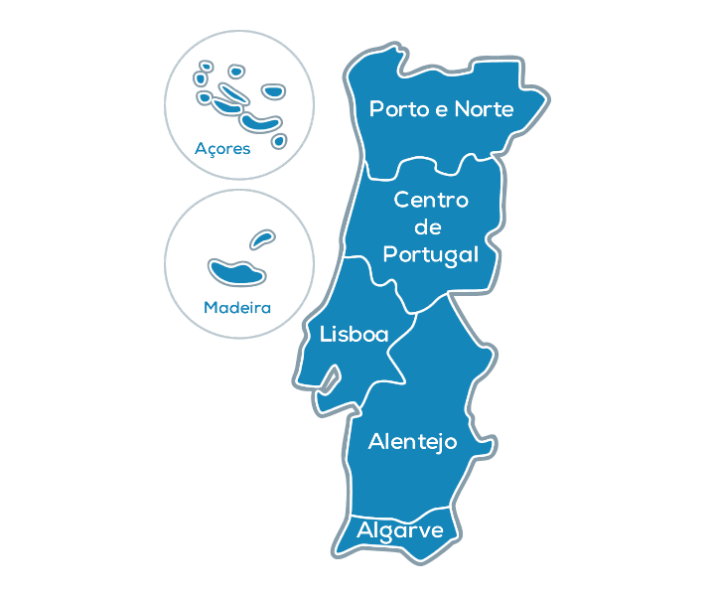
ALENTEJO CIRCULAR
Olive oil production
Wine production
Swine production

Slide 9
ALENTEJO CIRCULAR
GOAL:
- Sensitive and mobilize Alentejo economic agents in the ranks of olive oil, wine and pig’s farming.
It was launched on November 14th and aims the creation of values in agricultural and agroindustrial farm through the transfer of knowledge about practices and technologies for an efficient use of resources and recovery of waste.
Adoption of the Circular Economy model!

Slide 10
Our Concerns
Circular Cities or Regions vs Circular Territories (no border lines)
Legal barriers (need of an adaptative regulamentation to improve EC practices)
Complementarity between various sectors of activity

Slide 11
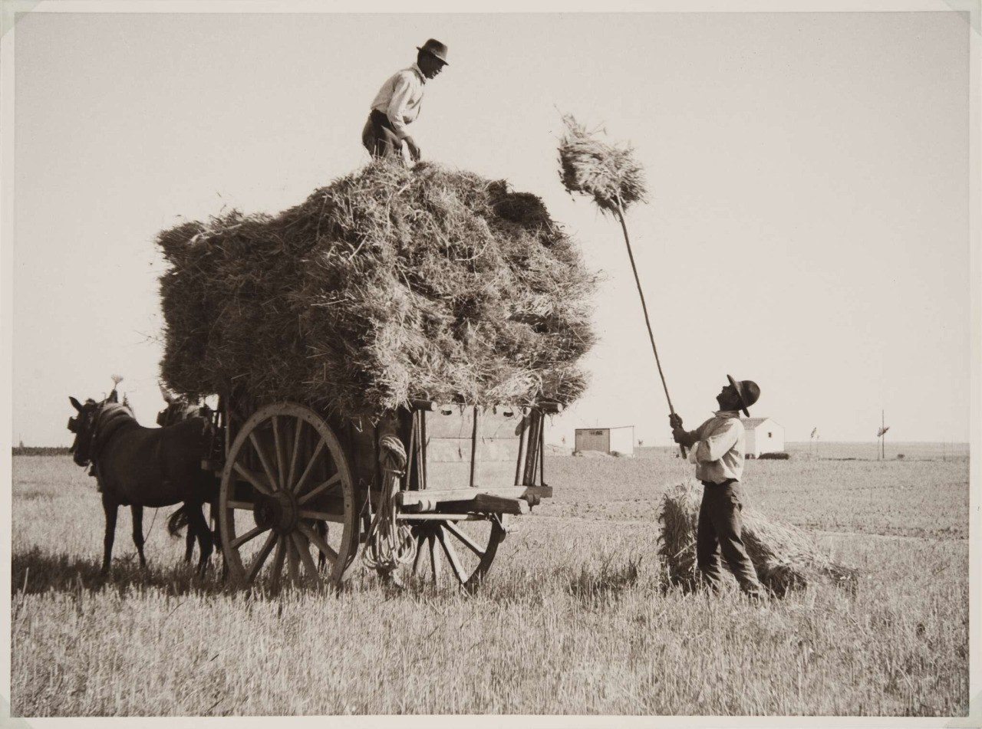
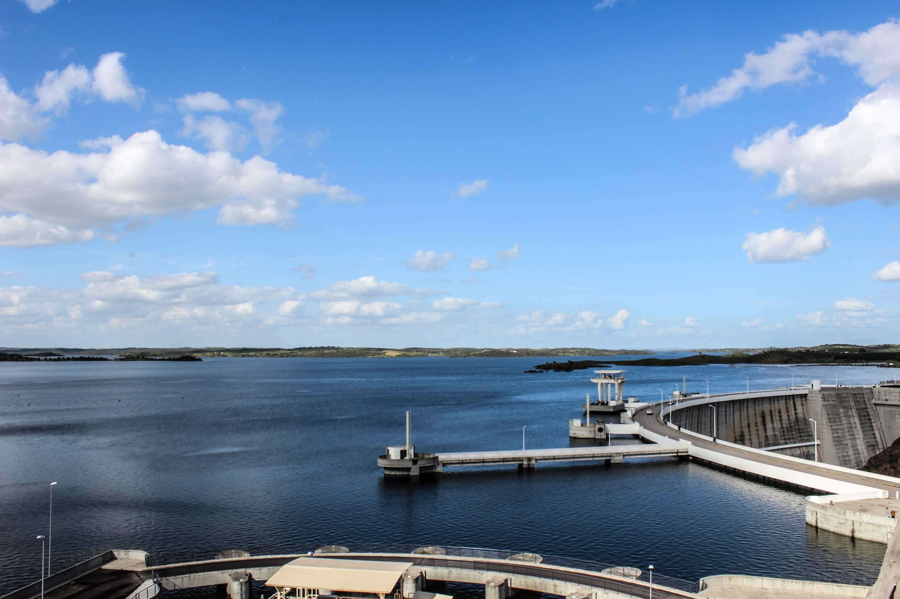
Thank you for your attention

